Slide 1
Rapid Response and Business Services
Monthly virtual meetings of our Statewide Rapid Response & Business Service Team
The counties are reporting on Rapid Response on a quarterly basis
No WARN Notices April, May, June
Small Businesses closures
Hawaiian Airlines Recruitment
Monthly Presentations: DVR, Isaia Souza, HSBDC
WDC Live: The Future of Work in Hawaii

Slide 2
Activities
Job Seeker Resources and Drive Thru Job Fair
Love’s Bakery affected employees completed computer training
Continuing to assist employers and affected employees
Hiring Events

Slide 3
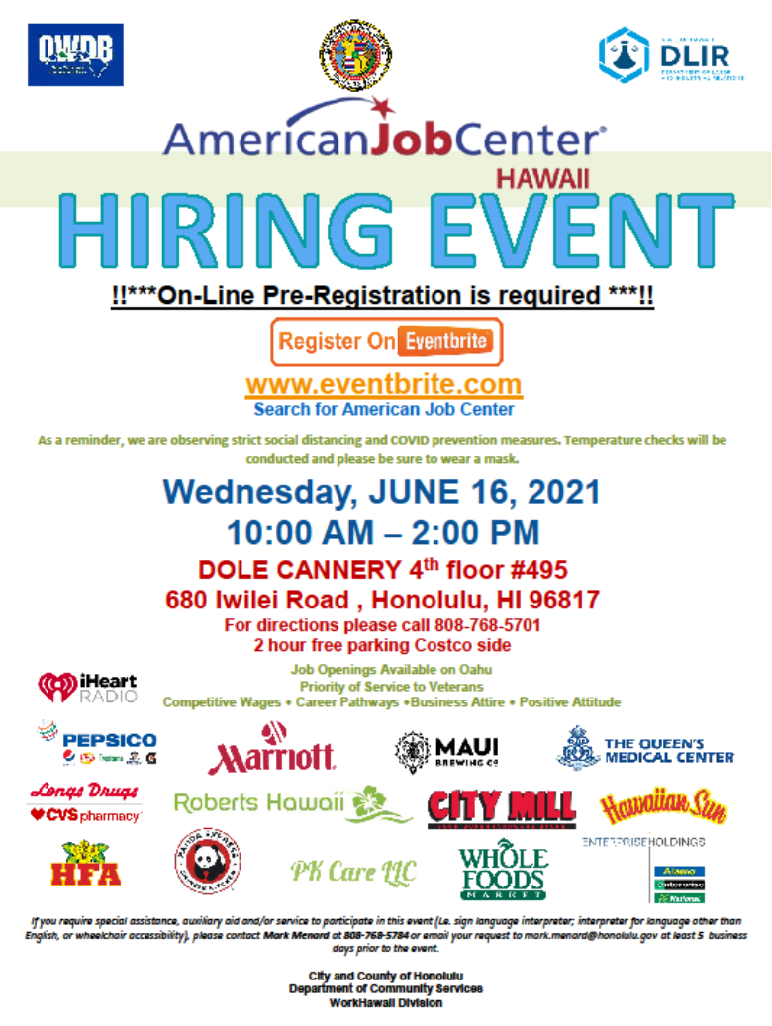
151 Attendees
14 Employers
City Mill, CVS Longs, Enterprise Holdings, Hawaii Food Alliance, Hawaiian Sun, iHeart Radio, Marriott Hotels, Maui Brewing, Panda Express, Pepsi Co, PK Care, LLC, Queen’s Medical Center, Robert’s Hawaii, Whole Foods.
5 Services Providers
Department of Vocational Rehabilitation (DVR), Waipahu Community School for Adults, Hawaii Alliance of Nonprofit Organizations (HANO), Workforce Development Division (WDD), American Job Center Hawaii (AJCH)

Slide 8
Veteran-Owned Businesses Ranked by the number of employees

Slide 9
Weekly Emergency Support Functions # 6 Mass Care, Emergency Assistance, Temporary Housing, and Human Services (ESF 6) meetings
COVID-19 Disaster Recovery Grants
13 employer worksites
City & County of Honolulu: 6
Hawaii County: 4
Maui County: 3
3 workers started in April

