Slide 1
WDD Programs &
Success Stories
June 23, 2021

Slide 2
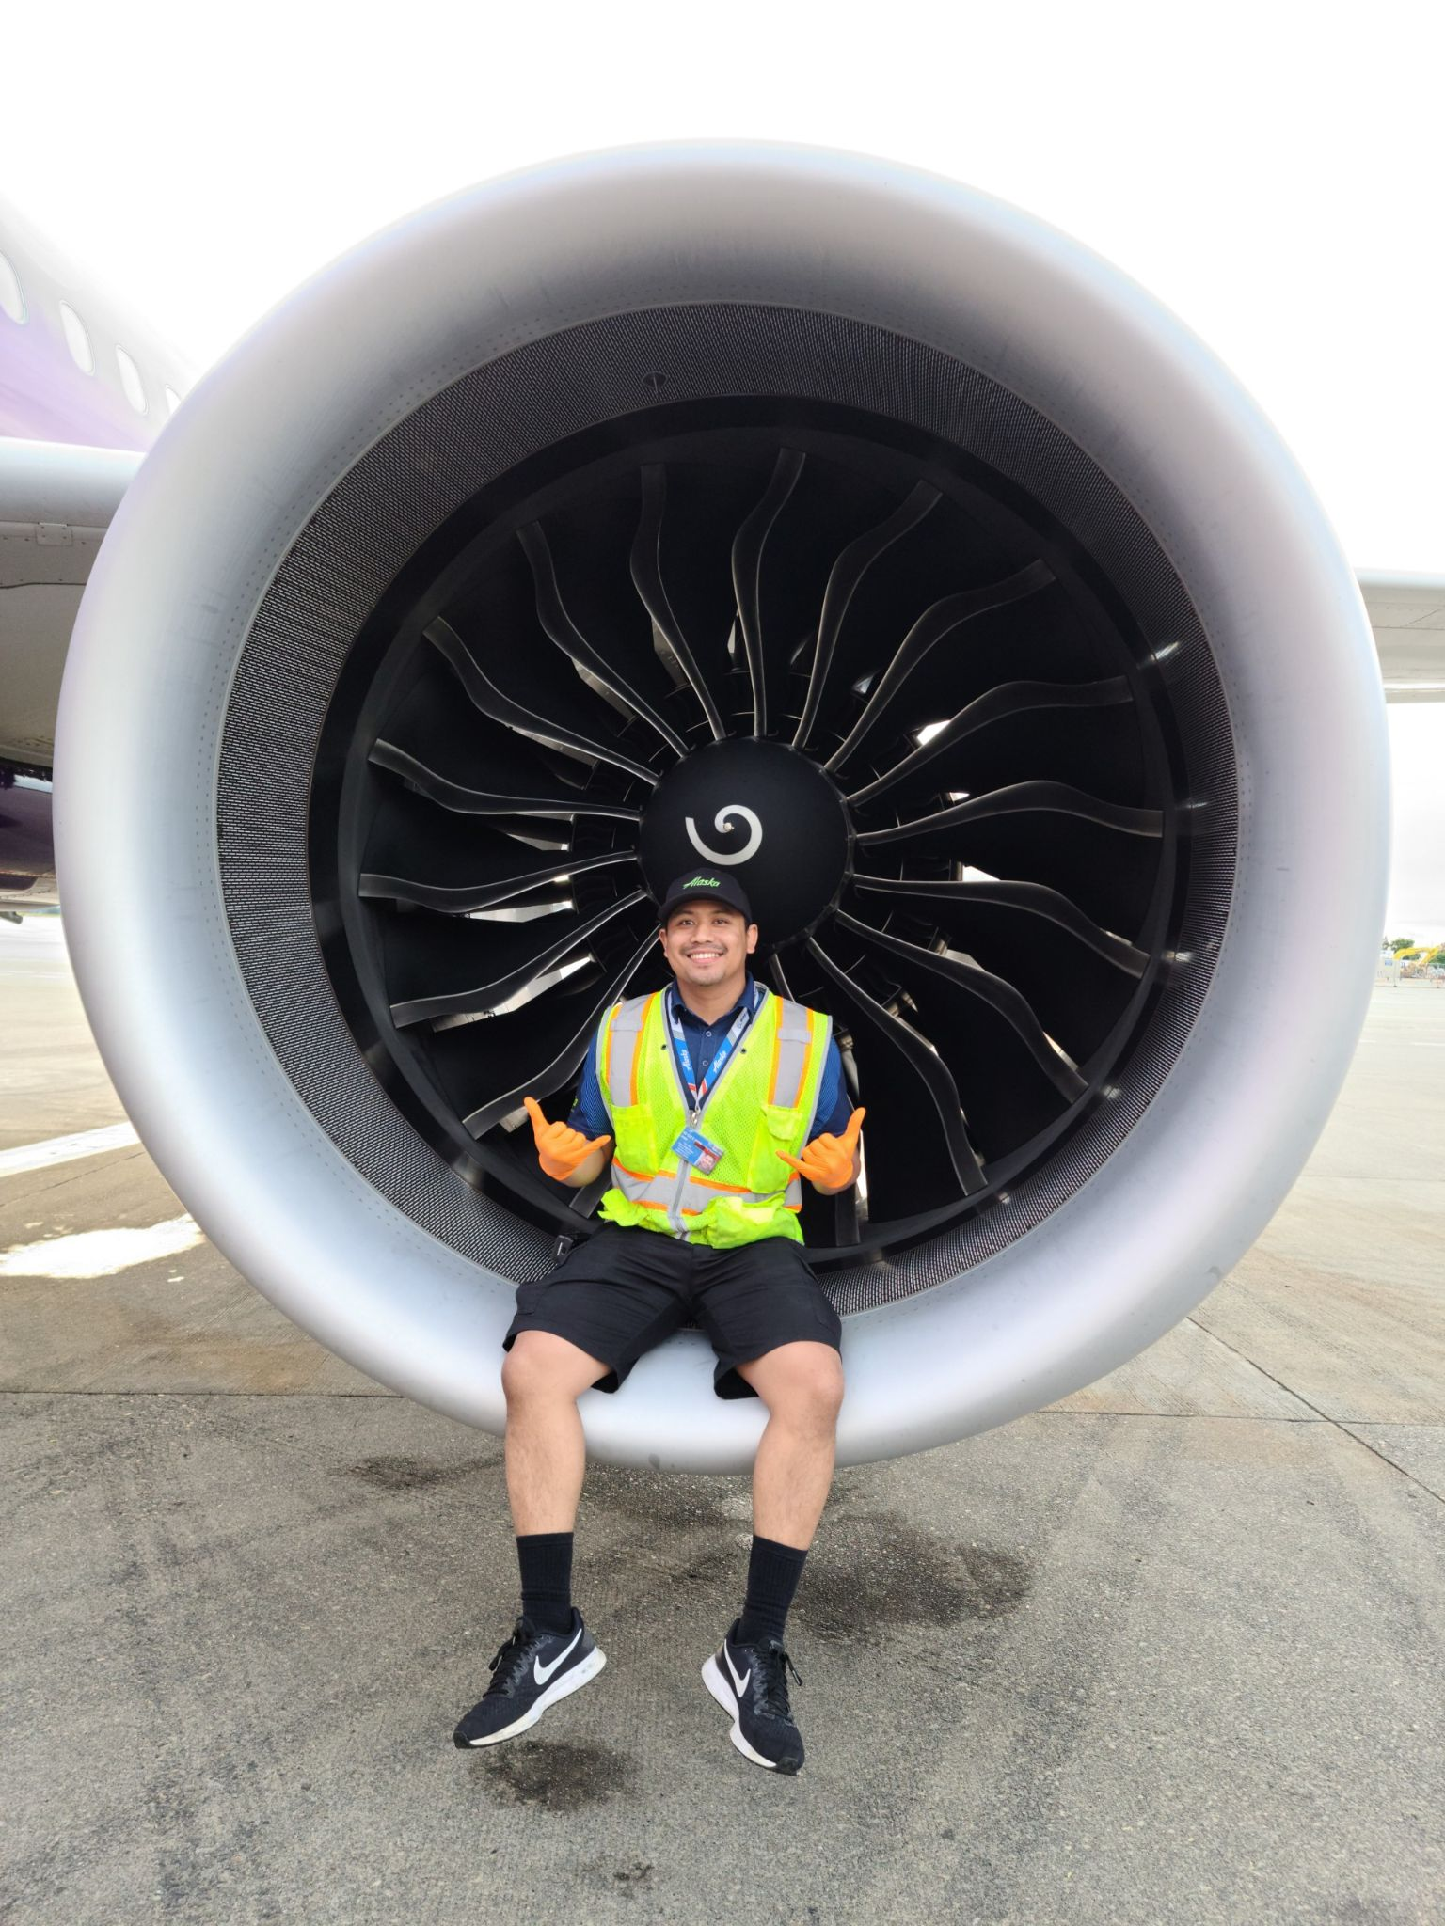
Flying Colors - Paul V. (Trade Adjustment Assistance)
Received layoff notice from HC&S closure in late 2016
Received TAA services through Maui WDD branch
Through transferable skills assessment, Paul was referred to Aeronautical Maintenance Tech (AMT) program
Received AAS degree in AMT and FAA certification
Recently received promotion, doubled pre-layoff wage

Slide 3
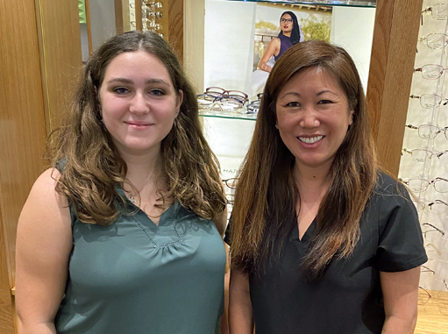
Clear Vision - Emily W. (Apprenticeship)
Prior to senior year, started dual credit studies at Kapiolani Community College
Enrolled as a pre-apprentice in KCC’s Optometry Assistant Apprenticeship Program through SAE grant
An apprentice as of June 2020, Emily is now working at Windward Vision Center.
“I am so happy doing what I do and I learn new things every single day. I never thought as a 17 year old I would know how to file insurance! It is such a great environment to work in and I am so glad with how everything worked out.”
Emily W.

Slide 4
Rapid Healthcare Education Programs (Apprenticeship)

Slide 5
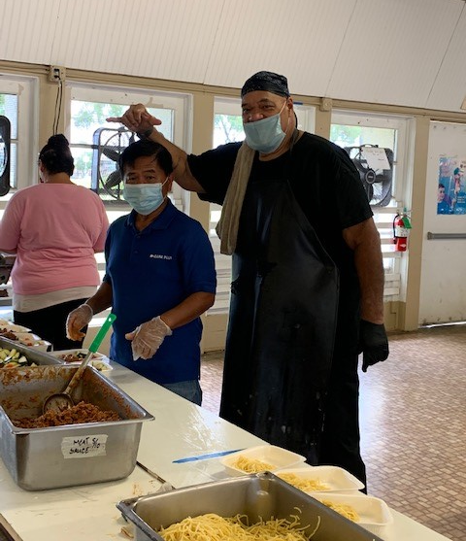
Finding his Niche (Senior Employment)
James B. entered the SCSEP program on 12/18/2018, he was placed at the St. Joseph School cafeteria where he found his niche and enjoyed every moment of his work. Throughout that time, this individual adopted his grandchildren and stressed the importance of obtaining full time employment to support his family. Through consistency, and unrelenting determination, and help from the SCSEP program, he was hired in a full-time permanent position with Hawaii County Economic Opportunity Council as a Kitchen Aide earning $12.00/hour.
Staff provided individualized services, which included counseling, job search, computer classes.

Slide 6
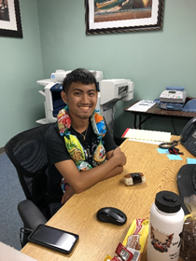
Honing New Skills (Disability Employment Initiative)
Rhowmar P. started the DEI program on November 1/31/2019. He has had to deal with challenges growing up and being in special education but hasn’t let it stop his desire to learn and grow as an individual. He enrolled to work improve his work skills and obtain his first official job.
Rhowmar was enrolled in Office Administration Skills program with Leeward Community College and was able to earn his Certificate in June 2019. He began his work experience at the YMCA of Honolulu starting in September of 2019. Unfortunately COVID put his work experience on pause. In September, he was placed in the City’s Rent to Work program where he worked until the beginning of Dec. 2020.
He wasted no time and gained employment in late 2020 with Times Supermarket at Kamehameha Shopping Center. This was his first official job and he remains a dedicated employee. He also has stepped up to help his mother financially as well as with his responsibility of taking care of his younger siblings. He continues to strive to succeed and does not let anything hold him back.

Slide 7
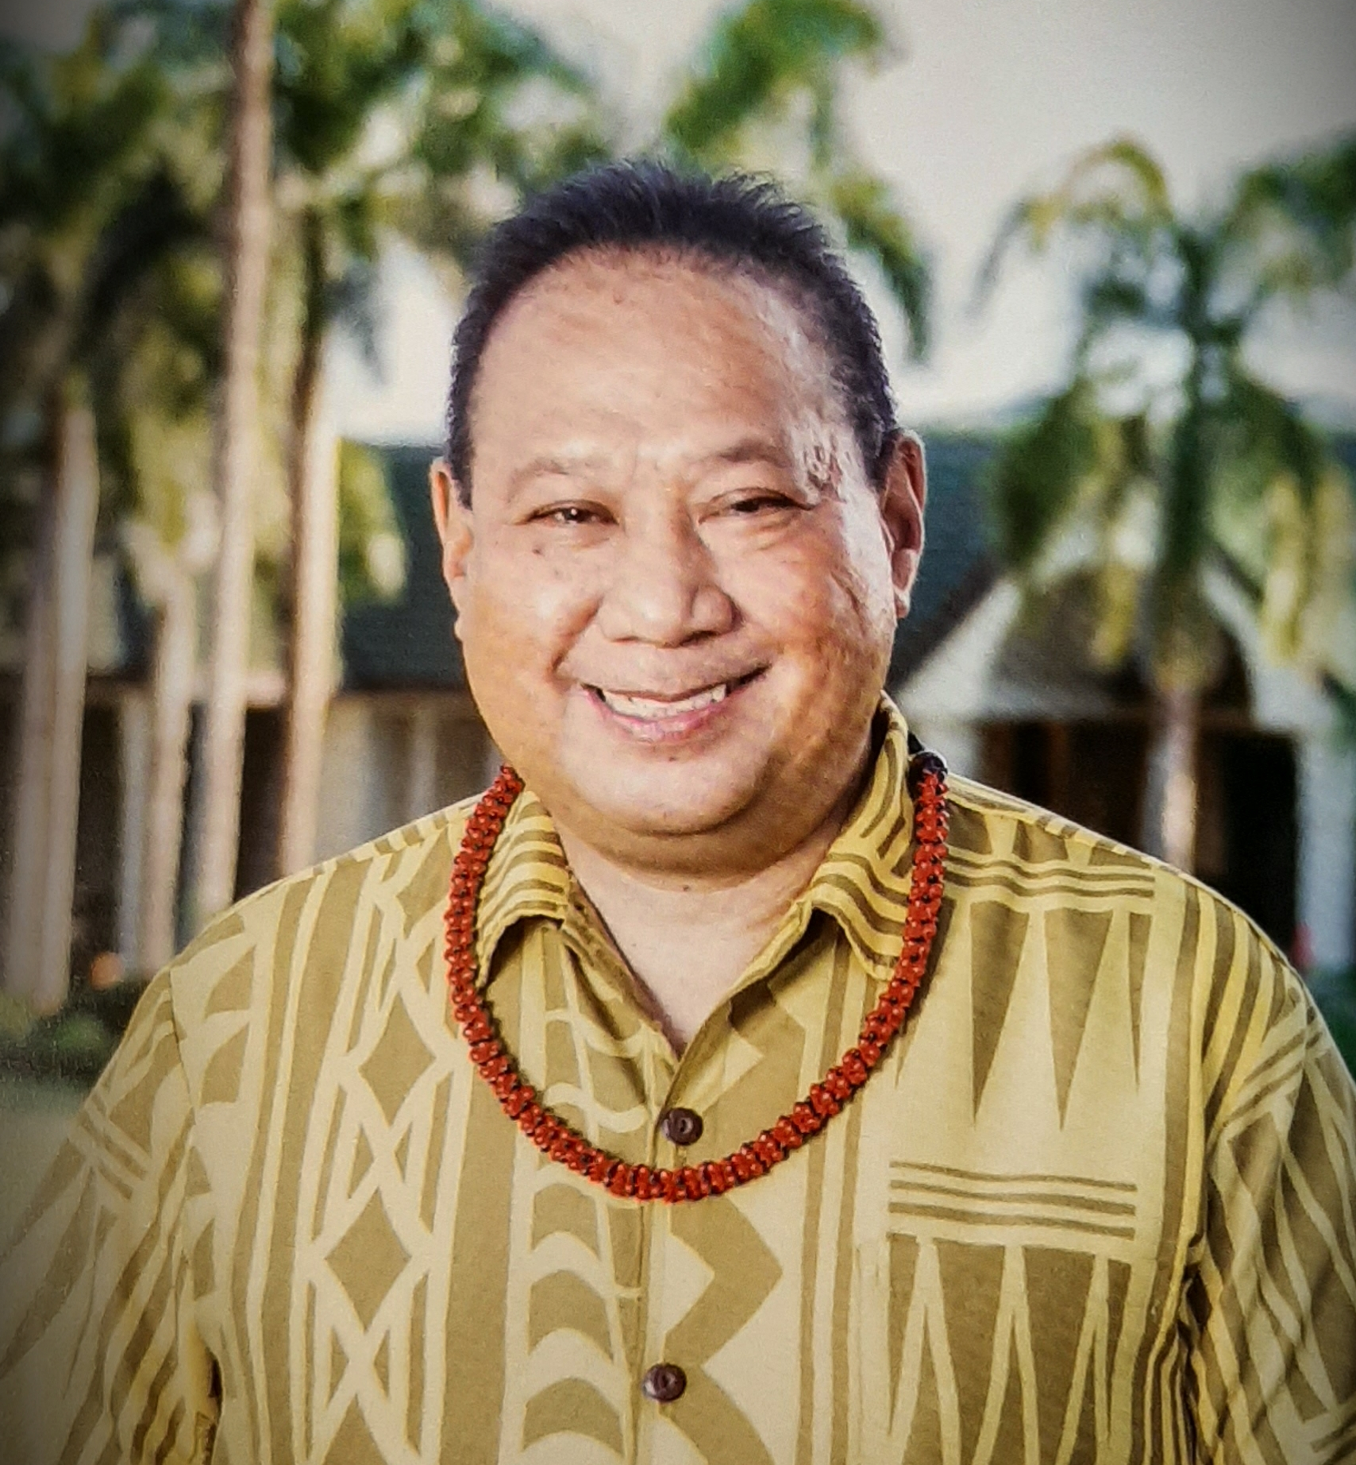
Back in Business (Reemployment Services)
Robert A. was one of the many furloughed in the hospitality industry due to Covid-19 restrictions.
Through CARES Act training funds, Robert was able to enroll in Basic Office Skills, Microsoft Office, Excel and other online courses which allowed him to enhance his resume.
As a result of the training, Robert applied and received an employment offer for an operations manager position at Sheraton Kauai Coconut Beach Resort.
He credits the RESEA staff and training with helping him return to work.

Slide 8
Additional WDD Programs & Grants
Employment & Training Fund (ETF)
Jobs for Veterans (JVSG)
Wagner Peyser Employment Services (WP)
Migrant Seasonal Farm Worker (MSFW)
Foreign Labor Certification (FLC)
Worker Adjustment and Retraining Notification (WARN)
First to Work (FTW)
Supplemental Nutrition Assistance (SNAP)
Work Opportunity Tax Credit (WOTC)
Fidelity Bonding Grant

Slide 9
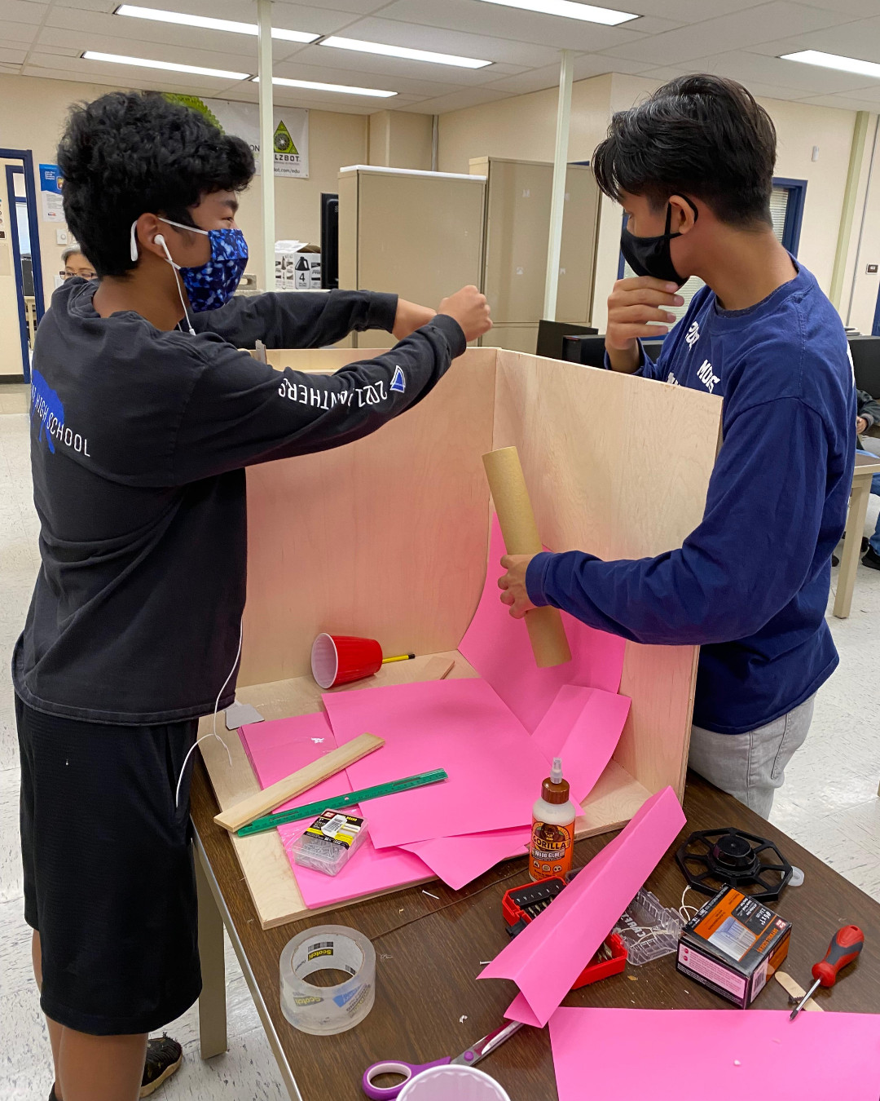
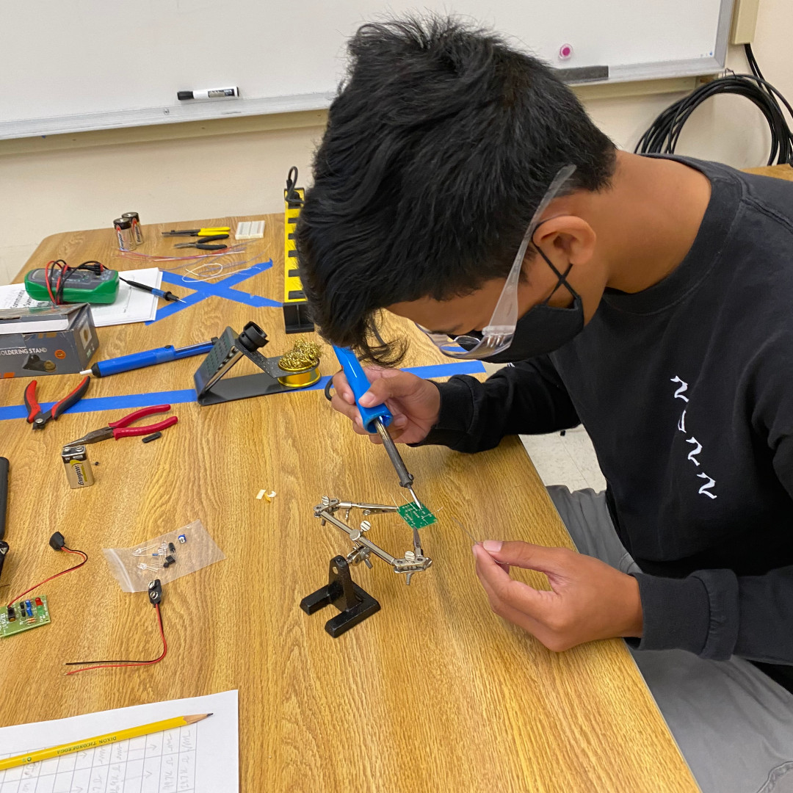
Workforce Grant Projects for 2021
Summer Engineering Academy
Entrepreneurship
Work-based Learning
CMfgA Manufacturing Cohort
Remote Work and Business Etiquette

Slide 10
HireNet Hawaii Instructional Video

