Slide 1
Effects of Receiving Training Services on Employment & Determinants of Employment Outcomes for WIOA Participants under Title I and Title III Programs, 2018-2020
Presented by
Bonhee Chung
Employment Analyst
Workforce Development Division
Hawaii State Department of Labor and Industrial Relations
8/3/2021

Slide 2
Count | Career Services |  | Training Services
 | n = 7346 | 96% | n = 295 | 4%
Sex
Male | 3985 | 54% | 97 | 33%
Female | 3204 | 44% | 198 | 67%
Age
18-21 | 185 | 3% | 20 | 7%
22-24 | 225 | 3% | 22 | 7%
25-44 | 2911 | 40% | 154 | 52%
45-54 | 1743 | 24% | 63 | 21%
55-59 | 982 | 13% | 25 | 8%
60+ | 1300 | 18% | 11 | 4%
Ethnicity/Race
Hispanic | 648 | 9% | 39 | 13%
Ameri Indian/Alaskan | 276 | 4% | 11 | 4%
Asian | 2287 | 31% | 129 | 44%
Black | 358 | 5% | 12 | 4%
Native Hawaiian | 2176 | 30% | 104 | 35%
White | 2793 | 38% | 110 | 37%
Multi-race | 1121 | 15% | 68 | 23%
Other Demographics
Veteran | 886 | 12% | 13 | 4%
Disabled | 640 | 9% | 13 | 4%
Unemployed | 6548 | 89% | 203 | 69%
Education Level
Secondary School Grad | 2990 | 41% | 127 | 43%
Some PS Edu | 1619 | 22% | 63 | 21%
PS Edu Cert | 333 | 5% | 20 | 7%
AS/AA Degree | 598 | 8% | 28 | 9%
BS/BA Degree | 1092 | 15% | 44 | 15%
Beyond BS/BA | 354 | 5% | 7 | 2%
Employment Barriers
Low Income | 908 | 12% | 168 | 57%
Older Individual | 2282 | 31% | 36 | 12%
Ex-Offender | 93 | 1% | 6 | 2%
Homeless/Runaway | 317 | 4% | 5 | 2%
BDS/English Learn | 58 | 1% | 13 | 4%
Single-parent | 194 | 3% | 37 | 13%
Long-Term Unemployed | 672 | 9% | 26 | 9%
Co-enrollment | 517 | 7% | 113 | 38%
Characteristics of the Participants
Program
Title I (Adult and Dislocated Worker)
Title III (Wagner Peyser)
Data Period
2018-2020
Total Number of Participants
7,641

Slide 3
Logistic Regression Model
What are the Determinants of Performance Outcomes?
 | estimate | std.error | statistic | p.value
(Intercept) | 0.226942243 | 0.139639427 | 1.625201766 | 0.104119574
X1col_trnserv | 0.99630965 | 0.144492114 | 6.895252777 | 5.37691E-12
X1col_female | -0.012823172 | 0.049239701 | -0.260423445 | 0.79453716
X1col_hispanic | 0.07252293 | 0.082784813 | 0.876041485 | 0.381007481
X1col_asian | 0.252110935 | 0.064650533 | 3.899595645 | 9.63535E-05
X1col_pacific | 0.211574196 | 0.06760816 | 3.129418036 | 0.001751529
X1col_white | -0.049310293 | 0.063422111 | -0.777493717 | 0.43686754
X1col_multirace | -0.103441028 | 0.094898022 | -1.090023008 | 0.275703009
X1col_elig_vetstatus | -0.066617049 | 0.09229126 | -0.721813196 | 0.470409336
X1col_disability | -0.271936773 | 0.096544794 | -2.816690185 | 0.004852131
X1col_employstatus | -0.571981169 | 0.074989087 | -7.627525471 | 2.39303E-14
X1col_secondarysch | 0.1775613 | 0.114688507 | 1.548204832 | 0.121572989
X1col_postsecondarysch | 0.108352605 | 0.12060225 | 0.898429377 | 0.368956681
X1col_postsecondarycert | 0.428488471 | 0.154343864 | 2.776193748 | 0.005499942
X1col_aa | 0.244121494 | 0.137083482 | 1.78082355 | 0.074941281
X1col_bachelor | 0.250806769 | 0.126141607 | 1.98829534 | 0.046779036
X1col_advbachelor | 0.070453153 | 0.155745147 | 0.452361784 | 0.651008373
X1col_lowincome | -0.19413995 | 0.096509863 | -2.011607341 | 0.044261345
X1col_olderind | -0.286368737 | 0.052494768 | -5.455186237 | 4.89215E-08
X1col_homeless | 0.100960284 | 0.156279089 | 0.646025546 | 0.518262812
X1col_eng_lit_cultbar | -0.863303509 | 0.273323541 | -3.158540624 | 0.001585612
X1col_singlepar | -0.208379067 | 0.157003769 | -1.32722334 | 0.184434814
X1col_longtermunemployment | 0.076942148 | 0.085115623 | 0.903972094 | 0.366010199
X1multiprog | 0.118676987 | 0.088397873 | 1.342532154 | 0.179423512

Slide 4
Determinants of Positive Outcomes (Employment after 2nd Quarter)
Participants who received training services are 2.7 times more likely to be employed than participants who received career services.
Asian and Native Hawaiian are 1.3 times more likely to be employed than other minority groups (Hispanic, Black, American Indian, etc.).
Participants who have postsecondary certificate or higher degrees are about 1.4 times more likely to be employed than participants who have less than a high school diploma.

Slide 5
Determinants of Negative Outcomes (Employment after 2nd Quarter)
The odds of being employed is 24% lower if the participant is an individual with disability.
The odds of being employed is 44% lower if the participant was unemployed at the time of entry.
The odds of being employed is 18% lower if the participant was a low-income individual.
The odds of being employed is 25% lower if the participant is an older individual.
The odds of being employed is 58% lower if the participant is an English learner.

Slide 6
What is the effect of receiving training services on the employment after second quarter (Q2ER)? How do we measure it?
Q2ER of Participants
(Training Service Recipients)
Q2ER of those who could have received training services, but did not participate in training services
Average Treatment Effect on the Treated (Program Effect)
Treatment Group
Control Group
(Counterfactual)

Slide 7
Who are the Treatment and Control Group in WIOA?
Training Service Participants
(n = 293)
Career Service Participants
(n = 7360)
Total WIOA Participants
2018-2020
(N=7653)
Treatment Group
“Potential” Control Group

Slide 8
Propensity Score Matching (Probability of Receiving Training Services based on Participant Characteristics)
Propensity Score of Participants
(Career Services)
Propensity Score of Participants
(Training Services)
(1) 0.014
(2) 0.198
(3) 0.079
.
.
(7359) 0.327
(7360) 0.542
(1) 0.323
(2) 0.135
(3) 0.015
.
.
.
(293) 0.721

Slide 9
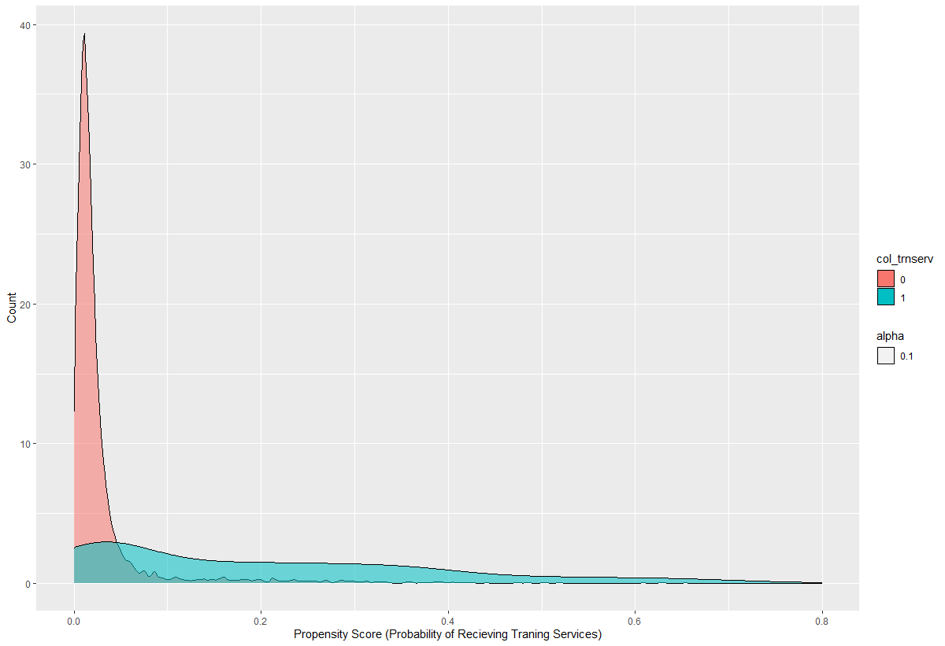
Receive Training Services
No
Yes

Slide 10
Estimation Result
Interpretation
If a participant receives training services, his or her chance of getting a job is about 27 percentage points higher.
Estimate... 0.26578
AI SE...... 0.039599
T-stat..... 6.7118
P-value...... 1.923e-11
Original number of observations.............. 7653
Original number of treated obs............... 293
Matched number of observations............... 293
Matched number of observations (unweighted). 424

Slide 11
Limitations
The type, eligibility, and quality of training services differ widely under Title I (Adult and Dislocated Worker) and Title III (Wagner Peyser) programs. Therefore, the estimate may not represent any specific program effect per se, but the effect of receiving any training services. Non-Generalizable
There could be other factors that affect the participation decision such as unemployment spell, motivation, innate ability, and (time) costs that are not easily observable. Not a perfect matching.

Slide 12
Further Research
To obtain more accurate estimates, I need to dissect and divide participants into subgroups according to their characteristics (gender, education level, type of training services received, etc.)
For more accurate propensity score and matching, I need to consider other important factors such as dates of enrollment, length of services, referrals or self-selection, funding availability, occupations before and after treatment, other pre-program conditions related to employment or unemployment, local economic conditions, etc.

Slide 13
THANK YOU

