Slide 1
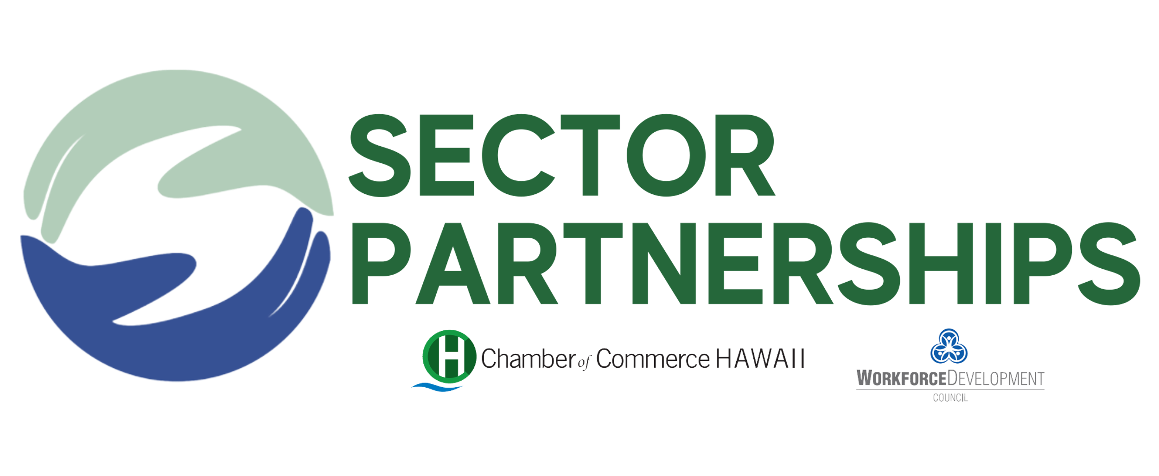
Sector Strategies & Career Pathways Update
July 28, 2021
Keala Peters
EVP, Education & Workforce Development
Executive Director, Sector Partnerships
Chamber of Commerce Hawaii

Slide 2
Today’s Update
Engineering Sector Partnership
Healthcare Sector Partnership
Technology Sector
Shipbuilding/Maritime Sector

Slide 3
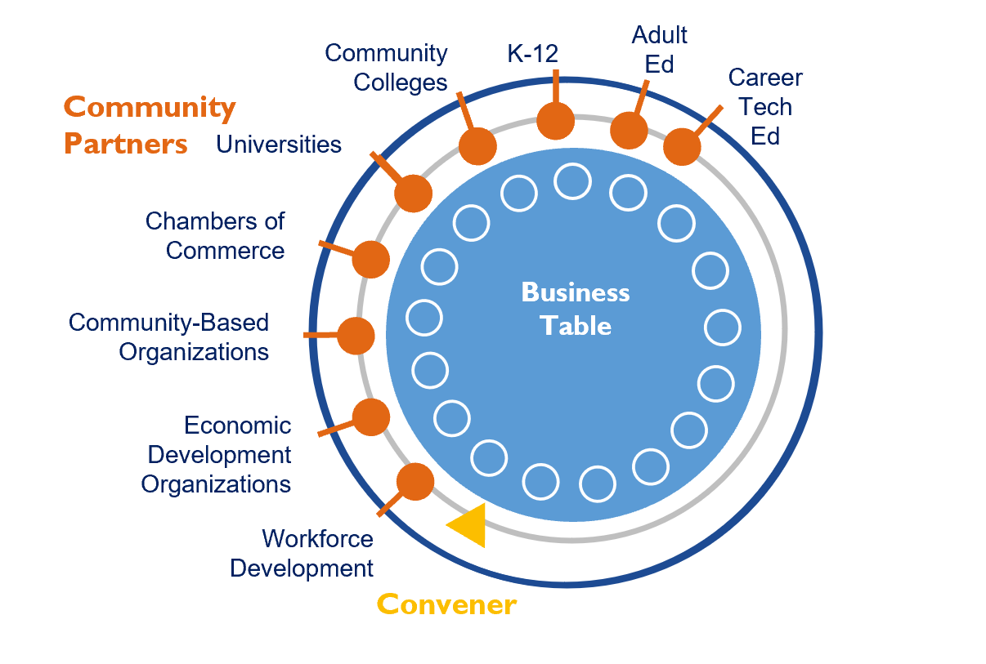
Sector Partnerships: Industry-driven Employer Partnerships
Collaboratives accomplish their workforce goals by:
Providing work-based learning to prepare talent for in-demand careers
Promoting career awareness and opportunities for underrepresented populations in each respective industry
Aligning educational training to necessary job skills

Slide 4
Convening & Funding Through the Years
2017 – 2020
Convened by UH and Chamber of Commerce Hawaii
Funded by Strada Education Network and Harold KL Castle Foundation
Support provided by Oahu Workforce Development Board
2021 (Jan – July)
Convened by Chamber + Workforce Development Council
Funded by Workforce Development Council
Convening support provided by SMS Research
Extending reach statewide
2021 (July - Sept)
Chamber funding SMS Research for continuity
2021 (Sept - June)
Seeking WDC/DLIR return as co-convener

Slide 5
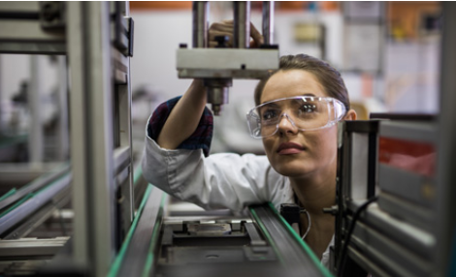
Engineering Partnership Update

Slide 6
2021 ENGINEERING SP FOCUS: Build a K to Career Engineering Pathway
Pilot School Complexes: Campbell, Castle & Waipahu

Slide 7
Expanding the Engineering Sector Partners
AECOM
Agor Jehn Architects
Akinaka & Associates, Ltd.
Architects Hawaii Ltd.
Army Corps.
ASCE
ATA Hawai‘i
Austin, Tsutsumi & Associates, Inc.
BAYER
Bechtel
Belt Collins Hawai‘i
Bills Engineering, Inc.
Booz Allen Hamilton
Bowers + Kubota Consulting, Inc
Burns & McDonnell Engineering Company
Carollo Engineers
Coffman Engineers, Inc.
Community Planning & Engineering
Consulting Structural Hawaii, Inc.
Dept. of Environmental Services
Dept. of Planning and Permitting
Dept. of Transportation
ECS Inc.
Electech Hawaii, Inc.
Ferraro Choi
Fukunaga & Associates, Inc.
G70
Geolabs
Gray, Hong, Nojima
Hawaii Board of Water Supply
Hawaii Unified
Hawaiian Dredging Construction
Hawaiian Electric Co.
HDR Engineering, Inc.
Healy Tibbits Builders Inc.
Hi.arch.y LLP
InSynergy Engineering, Inc.
Jacobs Engineering
KAI Hawaii
KCS Consulting, LLC
Kennedy Jenks
Layton Construction Co
Limtiaco Consulting Group
Lowney Architecture
Makaha Learning Center
Martin Defense Group
Mason Architects, Inc.
Michael Young
Miyashiro & Associates, Inc
MK Engineers, Ltd.
MKE Associates, LLC
Nagamine Okawa Engineers, Inc.
Nakamura, Oyama & Associates
NAVFAC
Nordic PCL
Notkin Hawaii, Inc.
Obayashi Design Group Inc
Oceanit
Okahara & Associates, Inc
Orion Engineers
OTIS
Pacific American Foundation
Pacific Geotechnical Engineers, Inc.
Park Engineering
QRSE, LLC
R.M. Towill Corp.
RIM Architects, LLC
Ronald N.S. Ho & Associates, Inc
Sam O. Hirota, Inc.
Sato & Associates
Shigemura, Lau, Sakanashi, Higuchi & Associates
SPAWAR Systems Center Pacific
SSFM International
Structural Hawaii, Inc.
Tanimura & Associates, Inc. (i3ngineering)
Thermal Engineering Corp.
Wilson Okamoto Corp.
WSP Parsons Brinkerhoff
Yogi Kwong Engineers
The 32 industry partners marked in bold are directly partnering with one or more of our pathway project school complexes.

Slide 8
FOUR SHARED PRIORITIES
Our discovery phase has yielded these shared priorities among our three school complexes (Waipahu, Campbell, Castle):
Career Awareness and Interest
Increasing STEM Interest among Female Students
Ensuring students are Math-Ready
Recruiting Advisory
Board Members
Exposure to various career paths within the STEM/Engineering industries, with awareness opportunities for students and parents beginning at the elementary-school level
Developing a sequence of opportunities for girls to gain exposure to STEM and engineering careers.
Exposing students to the math requirements needed to stay on track while in the K-12 pipeline, to be able to meet university engineering requirements and expectations
Convening industry and education partners to serve on an advisory board tasked with streamlining and strengthening WBL efforts within the school complex
Project-Based Learning (PBL), Job Shadows/Internships, and Teacher Externships will be foundational elements across the first three priorities.

Slide 9
Engineering K to Career Pathway Project
Workgroup Initiatives
Career Awareness
Women in STEM
Math Readiness
Engineering Resource Bank
Collect resources
Provide a shared platform for these resources to live and be added to
Engineering Career Presentations
Create age appropriate career awareness presentations for the elementary, middle, and high school levels
Engage with Parents
Develop resources for parent nights
Women in Engineering Speaker List
Create a shared contact list of female engineers to speak in classrooms
Speaker Toolkit
Generate a presentation outline and fact sheet for speakers
Include age appropriate activities and standard language to be used by speakers
Women in STEM Week in March
Plan a week of speakers, student presentations, etc. showcasing females in engineering
Engage with Parents
Develop resources for parent nights
Curriculum Support
Clarify DOE Math Landscape
Identify key math track decision points to better educate and inform families
Elementary Math Engagement
Get feedback from complexes on standards in need of support. Looking to focus on math concepts with regularly lower test scores. Circulating survey with schools.
Identify gaps and provide curricular and classroom support to “Make Math Fun”
Engage with Parents
Develop resources for parent nights
Work with counselors as a way to connect with parents and families on math requirements
Shared Workgroup Initiatives:
Engage in Parent Nights
Expand Internship and Job Shadow Opportunities
Increase Teacher Externships

Slide 10
Outcomes and Objectives
The steering committee is currently working to establish effective metrics to track progress on the following outcomes and objectives:
Improved technical and professional skillset among local engineering students.
Increased supply of local engineers in Hawaii.
Enhanced engineering program infrastructure in pilot school complexes.
Increased student engagement in engineering career options.
Increased alignment between secondary and post-secondary programs and careers.
Draft metrics will be circulated to the Full Sector Partnership for feedback and we plan to finalize and report on baseline metrics at the next full partnership meeting.

Slide 11
2021 Progression
Jan/Feb 2021 - Pilot school complexes met to plan and confirm priorities.
February 24, 2021 - Full Sector Partnership meeting with industry and school partners.
March 2021 - 18 new Industry partners matched to pilot school complexes!
April 2021 - Pilot school complexes met with new industry partners to share programming and engage industry in support opportunities.
May 11, 2021 - Full Sector Partnership meeting to allow for pilot school complex updates and to kick-off cross-complex workgroups meetings.
Summer - Workgroups completed 1 – 2 pilot projects
July 29, 2021 - Next Partnership meeting to unveil workgroup deliverables and plan for shared initiatives in the coming school year.
SY 2021 – 2021 - Employers participate in Parent Night, guest speaking, job shadows, etc

Slide 12
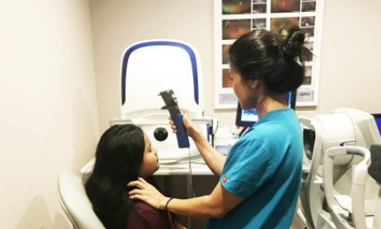
Healthcare Partnership Update

Slide 13
2021 Workforce Development Focus
The convening team surveyed the full Healthcare Sector Partnership to clarify 2021 priorities that emerged in the Dec 2020 meeting. A clear majority of respondents felt the partnership should focus on supporting workforce development efforts.

Slide 14
Launching a Healthcare Pathway Pilot Project
May 2020 – Shifted its focus and met with Healthcare Association of Hawaii (HAH) and Hawaii 2.0 to discuss alignment and opportunities for collaboration.
June 2020 - Steering committee met to discuss and consider initiatives to support and decided to move forward with a Pathway Pilot Project similar to the engineering sector.
July 2020 - Convening team has been organizing next steps by meeting with leaders in the DOE and healthcare sectors.
August to Fall 2020 - Steering committee will review collected information and proposed selection criteria to identify complexes to support in a pathway project this school year. The partnership will be inviting complexes to participate this fall and will follow a similar timeline to the engineering pathway project, launching the pilot project early next spring.

Slide 15
Technology Sector

Slide 16
Hawaii Technology Workforce Needs Report
Summer 2021: Talent pipeline landscape report will help align training with employer needs
Analysis will provide:
Supply and Demand overview
Skills and Competencies
Career Pathways for key entry level positions
Certifications
Includes LMI, employer survey, employer focus groups
Partners are UHCC & Harold KL Castle Foundation
Pre-cursor for Tech Sector Partnership work

Slide 17
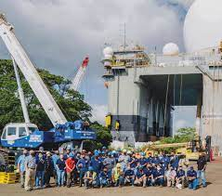
Shipbuilding/Maritime Sector

Slide 18
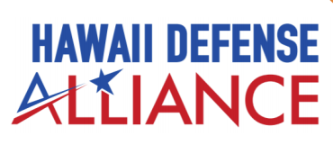
HI Defense Alliance: Shipbuilding Workforce
Defense spending = $7b; 102,000 jobs
HI Defense Alliance (DBEDT) focusing on Engineering, Technology, Shipbuilding workforce
Sector Partnerships will support:
Convening shipbuilders to support Advanced Manufacturing (Welding) Pathway at DOE high schools
Ensuring connection to HCC/Apprenticeship Program

Slide 19
Mahalo for your partnership!

