Slide 1
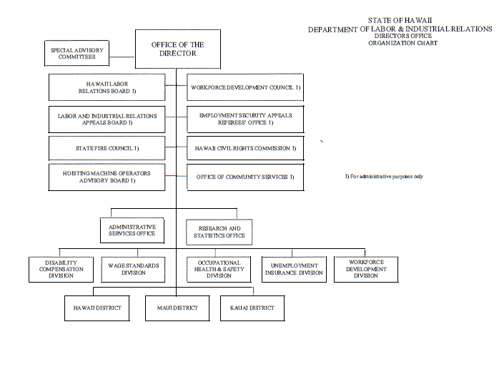

Slide 2
ACT 088 Effective June 24, 2021.
7 positions from WDC;
3 positions from Research & Statistics

Slide 3
10 positions added

