Slide 1

Hawaii Remote Work Pilot Project
State of Hawaii
Collaboration between the State of Hawaii:
Department of Business, Economic Development and Tourism
Department of Labor and Industrial Relations, Workforce Development Council and Workforce Development Division
Broadband Hui, Broadband Strategy Officer

Slide 2
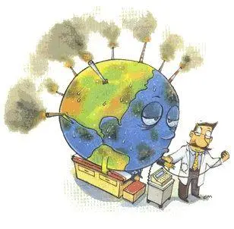


DBEDT Economic Innovation Team (EIT)
Expand Hawaii’s measures beyond traditional measures of an economic system to include measuring the well-being of Hawaii’s people, culture and environment.
  DBEDT/READ is also engaged with UH and HPU on updating and carrying forward the Genuine Progress Indicator (GPI)
The underlying culture of how we solve economic issues “The How Matters”
  Collaboration
  Objectivity – Based on data
  Mutual Respect
  Spirit of Can!

Slide 3

Remote Work in the Global Labor Market:
Microsoft 2021 Work Trend Index: Annual Report – The Next Great Disruption Is Hybrid Work – Are We Ready?
7 need to know hybrid work trends for 2021
Flexible work is here to stay.
  66% of leaders surveyed say their company is considering redesigning office space for hybrid work.
  73% of employees want flexible remote work options to stay.
Talent is everywhere in a hybrid work world
  Remote job posting on LinkedIn increased more than 5 times during the pandemic
https://www.microsoft.com/en-us/worklab/work-trend-index/hybrid-work

Slide 4

Remote Work in the National Labor Market
National Council on Compensation Insurance
Remote Work Before, During, and After the Pandemic – Q4, 2020 Economic Briefing
  Before the pandemic, only 6% of the employed worked primarily from home and about three-quarters of workers had never worked from home.
  In May 2020, over one-third of the employed worked from home due to the pandemic – a close match for pre-pandemic estimates of the share of work that could be done remotely.
  Most workers and employers expect to permanently implement more flexible remote work opportunities after the pandemic.
Job Losses and Physical Proximity – Q2, 2020
  The largest percentage of job losses during the pandemic came in economic sectors with large shares of high-proximity workers.
https://www.ncci.com/SecureDocuments/QEB/Insights_QEB_2020_Q2-PhysicalProximity.html
https://www.ncci.com/SecureDocuments/QEB/QEB_Q4_2020_RemoteWork.html

Slide 5


Remote Work in Hawaii’s Labor Market
Job listings identifying Remote Work are on the rise.
Duration of time that a posting is listed is declining
Median salary for on listings that include remote work are increasing.
What’s happening with occupations are being recruited in remote work?

Slide 6
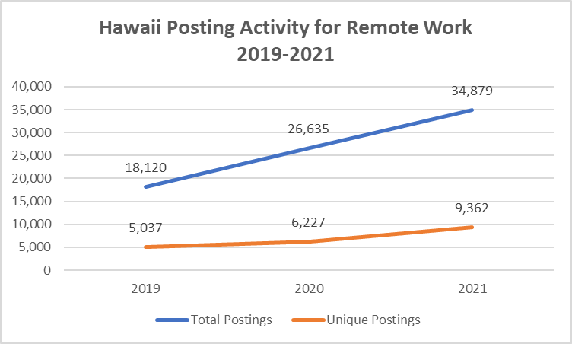
1. Job listings identifying Remote Work are on the rise.
The Year over year percentage change suggest that businesses posting jobs for remote workers is becoming more efficient.
Business identifying remote work in their job listings, don’t have to post their listings in as many locations AND are posting more positions identifying Remote Work in their job listing.

Slide 7
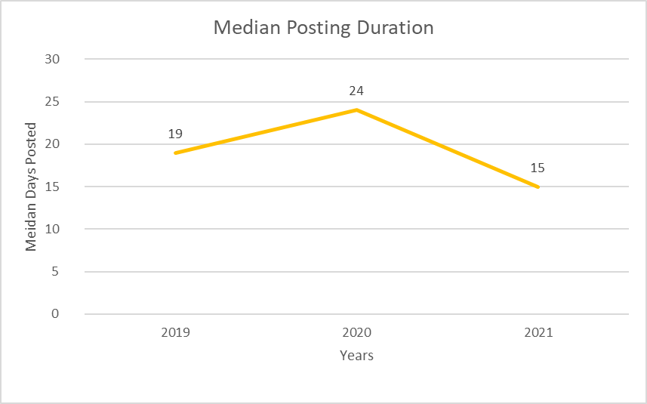
2. Duration of time that a posting is listed is declining.
In 2020, employers posted jobs that referenced remote work in their listing 5 days longer than in 2019. 2020 was the transition year to remote work.
In 2021, employers posted jobs that referenced remote work in their listing 4 days less compared to 2019 and 9 days less than 2020.
This suggests that response rates to job listings that reference remote work are being filled at a faster rate prior to the pandemic in 2019.

Slide 8
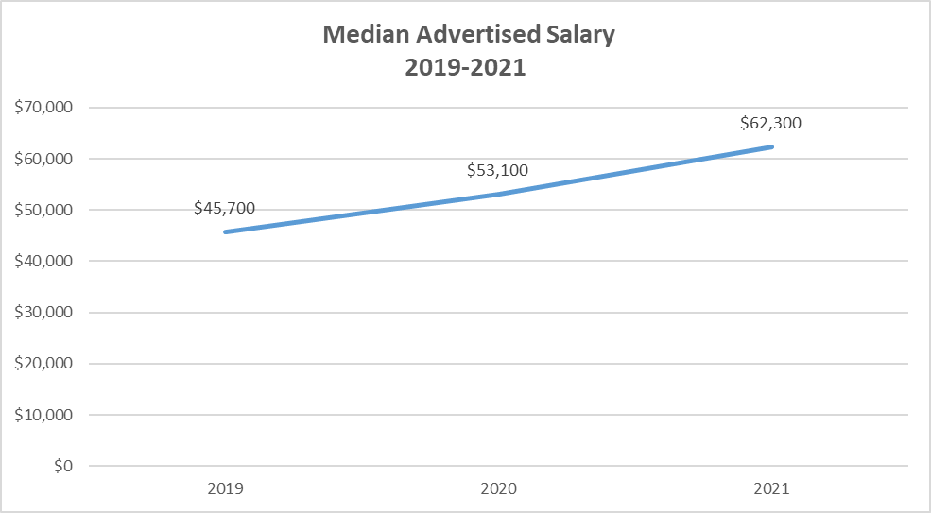
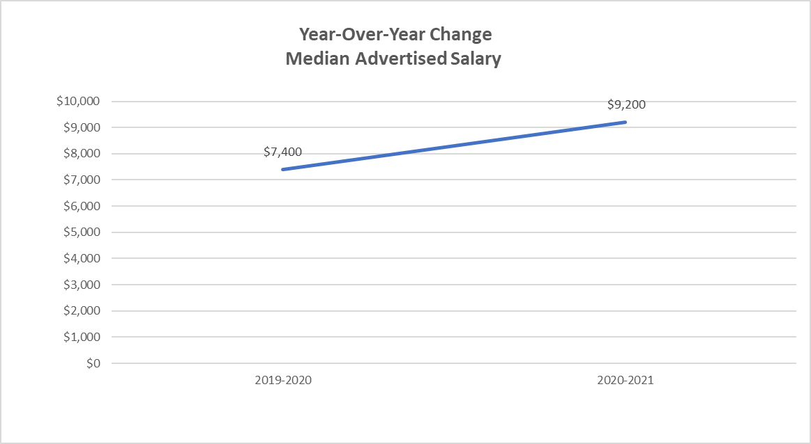
3. Median salary for listings that include remote work are increasing.
Between 2019 and 2020, the median annual salary on listings that include remote work for positions in Hawaii increased by $7,400 or 16%. Between 2020 and 2021, median annual salaries increased by $9,200 or 17%.
The increase in Median annual salaries suggests that either annual income is increasing and/or the types of occupations are changing.

Slide 9
4. What’s happening with occupations recruited in remote work?
What’s remained the same?
Three occupations remained highly posted in 2019, 2020, and 2021.
Insurance Sales Agents
Customer Service Representatives
Software Developers and Software Quality Assurance
What’s Changed?
Between 2019 and 2020:
More technology occupations
Computer User Support Specialist and Other Computer Occupations displaced Postsecondary teachers and Tutors and Teachers and other instructors.
Between 2020 and 2021:
Posting for management positions were in the top 5 occupations
Marketing Managers displaced Computer User Specialists

Slide 10


More data to come…
The DBEDT Hawaii Remote Work Survey
The Research, Economic Analysis Division (READ) of DBEDT has contracted and is working with Anthology, a local research firm to survey both Hawaii employers and employees to address business readiness and household appetite for remote work.
  Surveys are being conducted to a random sample of employers and employees. Please help us by completing the survey if you receive it.
    Employers n=1,600
    Employees n=4,700
  Target survey completion date: November 15, 2021
  Final Report: December 31, 2021

Slide 11
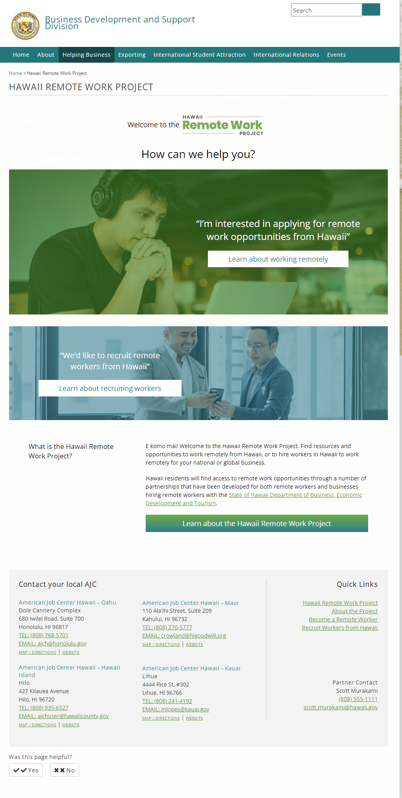
Hawaii Remote Work Pilot Project and Website
Hawaii Remote Work Pilot Project is a constant collaboration between DBEDT, DLIR WDC, and WDD, as well as the Broadband Hui
  Supports the Broadband Hui’s motto of ALL – Access, Literacy, and Livelihood.
    Increasing the opportunities for livelihood
    Increasing access and literacy through the refurbished laptop computer initiative and the Workforce Resiliency Initiative
Recognizes and provides a needed foundation in “livelihood” to address the existing digital divide and digital inequity.
Part of a larger effort to increase the export of professional services.
Designed to provide Hawaii’s unemployed, underemployed, and disadvantaged with a hand-up by facilitating the transition and adoption of remote work opportunities.
Most importantly, this project recognizes that “brain drain” is no longer an issue about geography.
https://invest.hawaii.gov/remote

