Slide 1
The Aviation Learning Center Contribution to Hawaii Workforce Development

Slide 2
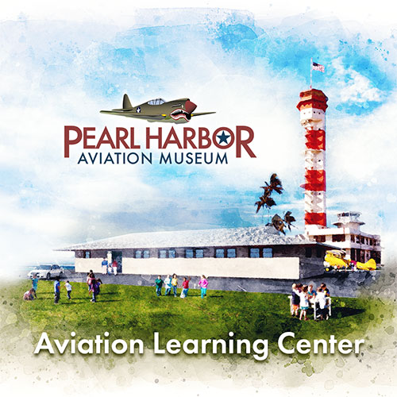
The ALC Experience:
The Aviation Learning Center (ALC) at the Pearl Harbor Aviation Museum offers a hands-on learning experience that immerses students in multiple aspects of aviation through three dynamic learning areas.
The program is geared toward three academic age groups; upper elementary (4-5), middle (6-8), and high school (9-12)
The activities at each grade level are designed to be age appropriate experiences and are aligned to current educational standards
The building itself is an authentic WWII Link Training Center, the pilot training technology of the 1940’s.

Slide 3
Elements of the Aviation Learning Center
The ALC consists of three rooms, each containing its own educational module. Students are paired into teams for their
Trek through the three modules. The Students journey through learning basic aviation concepts, planning and preparing an aircraft for flight, and finally applying all the acquired knowledge and preparation by making the flight.

Slide 4
ALC
THE LEARNING LAB
THE HANGAR – Cessna 152 installed
THE SIMULATOR BAY – flight simulators using
Lockheed Prepared 3D software

Slide 5
CURRICULUM
The ALC curriculum is fully aligned with State of Hawaii Common Core Standards and Hawaii DOE subject matter standards.
The ALC curriculum is built on national STEM standards.
Supporting instructional materials and teacher training strategies are included as part of the program to assist educators in preparing student for their ALC experience.
PHAM will expand and develop additional ALC curriculum to include specialized participation by such youth organizations as Scouts, CAP, JRROTC and others.

Slide 6
ALC Tie to Career Exploration
Current research shows that the U.S., and Hawaii, in particular, is facing a critical shortage of pilots, technicians, and engineers.
Hawaii has a great need for STEM education activities that can be accessed by low-to-moderate income individuals and groups in a flexible, informal setting.
The ALC is the premier platform to introduce aviation careers and the aviation enterprise to Hawaii students using hands-on techniques

Slide 7
The Pathway
The educational programs provided by PHAM augment the study of science, technology, engineering, and math, the STEM fields within the context of history.
The ALC is a powerful addition to the PHAM educational mission open to school groups, youth organizations, educators, and potentially, families (resident and visitors seeking weekend experiences).
PHAM is the only educational enterprise in the state to offer a full spectrum of aviation educational programs from 3d grade to College.
PHAM provides specialized aviation programs, virtual options, and summer camps that provide immersive experiences, introducing campers to mentors and a career website exploring key aviation / tech fields
PHAM provides academic and training scholarships to help students continue their aviation interests, advancing their skills and ultimately, preparing for employment – scholarships range from $500 to $10,000.

