Slide 1
Maui County Resource and
2:30-5:30pm
FRI
Velma McWayne Santos
Wailuku Community Center
DEC 10

Slide 2
Details: Maui County Resource and Job Fair
Wailuku Community Center/Velma McWayne Santos Community Center
395 Waena St. Wailuku HI 96793
December 10th, 2021
Rapid Response / Support Services 11:00pm-3:00pm
Job Fair 2:30pm-5:30pm
Parking
In front of the community center and side parking lot at Papohaku Park
Employers and Rapid Response Totals
Tables
32 Employer Tables, 15 Rapid Response Tables, 6 Provider Tables (outside)
People
64 Employers, 32 Participants Allowed at a time
30 Rapid Response People Total(2 presenters, 28 participants/session)

Slide 3
Providers
Providers
Maui County Job Fair
Rapid Response
Overflow/Rest Area

Slide 4
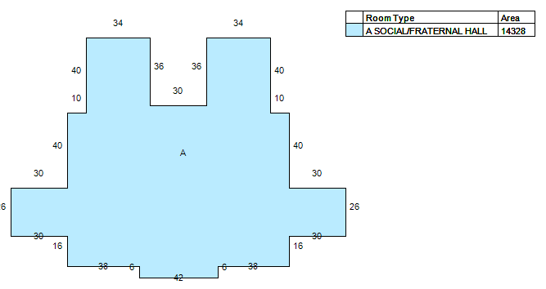
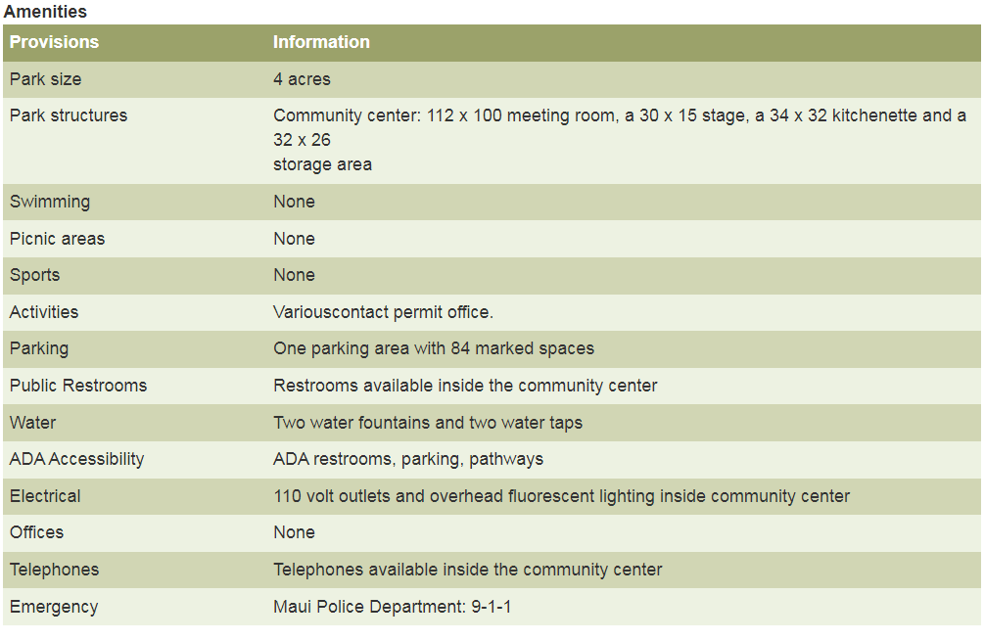
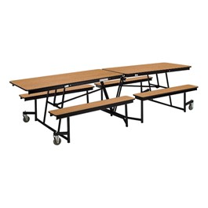
Velma McWayne Santos Community Center
Parking lot
Check in
Meeting Room
Bathrooms
Entrance
Check in
32 Employer Tables
14 Rapid Response Tables
6 Provider Tables
Sanitation Station
6’ distancing
Table Storage Room
Kitchen
Max Capacity for tables
46 Total Inside Tables
30 RR, 32 Employers = 62 people
Exit
Exit

Slide 5
Health and Safety Protocols
Each participant will have their temperature taken, their contact information recorded at entry, and will be required to sanitize before entry.
Masks will be required by all participants throughout the duration of the event extra masks will be available to hand out.
Sanitation stations will be at the entrance and exits of each event.
Handwashing stations will be available in the bathrooms located nearby.
The entry will be marked for 6 foot for social distancing.
Distance between tables, walkways, and all participants will be 6 foot social distancing.
Participants will walk along a pre-determined, one-way, path that has a separate entrance and exit.
After tables are used, they will be wipe down and sanitized by staff/volunteers.

Slide 6
Maui County Resource and Job Fair Friday, December 10th, 2021
Public Front Entrance to Community Center
Participants will park in the front or side parking lot and enter through the front of the building.
Then check in at the table located before the entrance (in front of yellow handrails)

Slide 7
Maui County Resource and Job Fair Friday, December 10th, 2021
Public Front Entrance to Community Center
They will have their temperature and masks checked and sign in with their names and contact information.
There will be a sanitation station set up before they enter the event and handwashing stations are located in the bathrooms near entrance.

Slide 8
Maui County Resource and Job Fair Friday, December 10th, 2021
Public Front Entrance to Community Center
Providers will have tables set up along the entrance to deliver information and available support to the public.
A total of six tables will be placed for the providers. Each table will be able to sit two staff, with six foot social distancing, for a total of 12 staff members at these tables.

Slide 9
Maui County Resource and Job Fair Friday, December 10th, 2021
Rapid Response Event
Services are available to all Maui County residents who are in need of employment/resource support.
Sessions will be 30 minutes long
From 11:00-3:00pm
28 participants per session with 2 presenters
Participants will enter from the front entrance and exit through the back of the building.
Tables will be in rows that are socially distanced by 6 feet between participants.

Slide 10
Maui County Resource and Job Fair Friday, December 10th, 2021
Employers/Job Fair
Tables will be set up more than 6 feet apart, with a one-way path winding through the event leading towards the exit.
No more than one participant will be allowed to visit each employer table at a time.
Each employer table will be allowed a maximum of 2 staff
Sanitation supplies will be provided to employers for in order to wipe down their tables after each participant interaction

Slide 11
Maui County Resource and Job Fair Friday, December 10th, 2021
Overflow/Rest Area
The grassy area located on the East side of the community center will be designated as a waiting area for Rapid Response participants who are waiting for entry into the event.
Masks are required in this area and available to anyone who needs one

