Slide 1
Rapid Response and Business Services Report Performance Measures and Accountability Committee October 25, 2021

Slide 2
Activities
Monthly team meetings
Continuing to assist employers and affected employees
Hiring Events

Slide 3
Hiring Events
Kauai County, two day Hiring Event featured 15 employers.
Oahu, Hiring Event, August 3, 2021. 28 Employers and Service Providers.
Maui County, Drive Thru Hiring Event
Hawaii County, Virtual Hiring Event

Slide 4
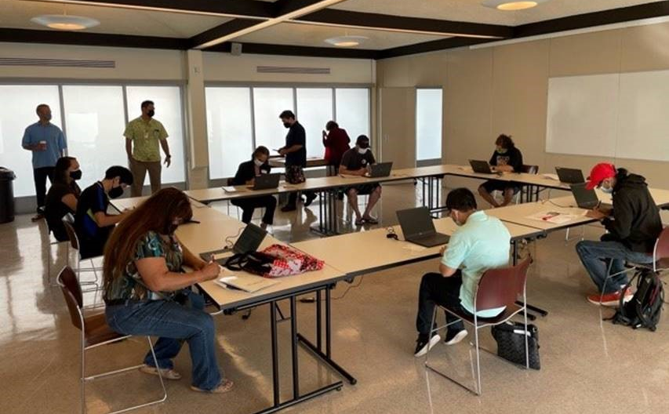
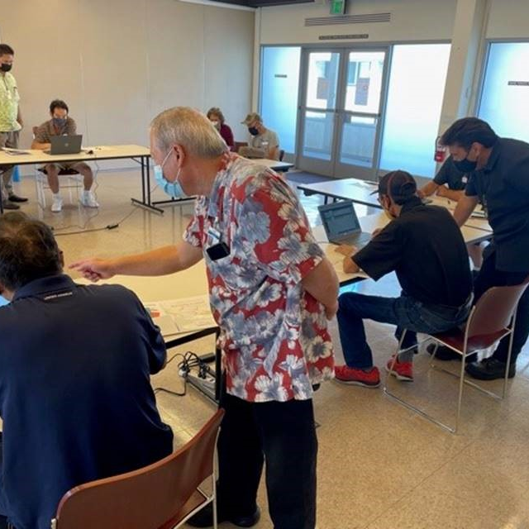
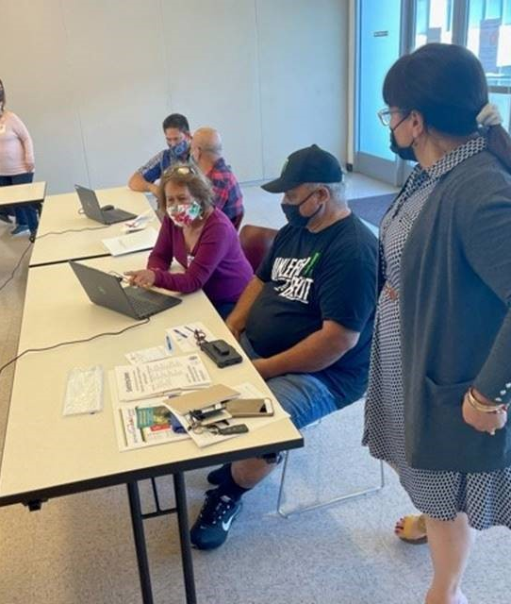

Slide 5
WARN Notices July 1, 2020 – June 30, 2021
146 WARN Notices
32,587 affected employees
Oahu-80
Affected employees 18,572
Maui-46
Affected employees 8,770
Kauai-20
Affected employees 1,882
Hawaii-19
Affected employees 3,363

Slide 8
COVID-19 Disaster Recovery Grant
22 employer worksites
3 worksites pending
City & County of Honolulu: 10 Employers, 8 Placed, 2 in process
Hawaii County: 4 Employers, 6 Placed 4 in progress
Maui County: 8 employers, 3 Placed 1 in progress
* as of 10/6/2021

