Slide 1
Hawaiʻi county workforce Development board Executive director report
Sandra Goodale February 8, 2022

Slide 2
American JOB CENTER has served 17,706 individuals since opening in DECEMBER 2017
2018
3,340
2019
4,317
2021
5,123
2020
4,565
2022
January 307
March 2020 – COVID 19
Delta Variant
Omnicron

Slide 3
WIOA TRANSITION
From Office of Housing to Research and development
Effective January 18, 2022 WIOA Program and the Local Workforce Board staff were physically moved from Office of Housing located at 1990 Kinnole Street to Research & Development located at 25 Aupuni Street.
The transition has been seamless for the American Job Center, The Local Workforce Board, the Workforce Innovation and Opportunity Act Service Providers and the Community.
With the transition there are many opportunities for collaboration between sectors and workforce development. More to come on this…

Slide 4
UP & COMING
The American Job Center and the Business Services Team are working with Big Island credit unions on an in-person/virtual job fair for March/April.
USDOL’s statewide monitoring of the COVID-19 Disaster Recovery Grants is being held February 7-14, 2022.
Fiscal monitoring of the WIOA program is being slated for February 2022.
Program monitoring of the Adult/DW/Youth programs are slated for March 2022.
The Supplemental Agreement for Program Year (PY) 21 Youth services has been signed by Goodwill and is being circulated at the County for execution.
The lease for the American Job Center was extended.
Currently working on the RFP for the One-Stop Operator - now that WIOA has been transitioned out of Housing.
Working on recommendations for Board vacancies.

Slide 5
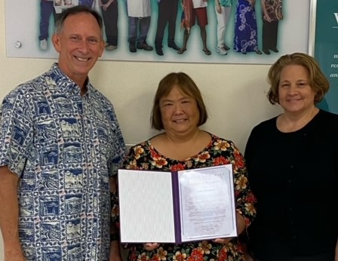
Mahalo ANN Ebesuno
Ann- retired from Hawaii Government Employees Association and the Hawaii County Workforce Development Board January 31, 2022. She served on the HCWD Board for over 6 years. Ann’s interest in becoming a Hawaii County Workforce Development Board Member “To ensure the creation of good paying jobs to sustain a strong economy and allow our children to raise families here in Hawaii rather than going abroad.”
HCWDB 2015-2021 Laborer Organization representative

Slide 6
Upcoming MEETINGS workforce Development council February 10, 2022 AJC partner meeting is February 17, 2022 Business engagement 3/2, 5/4, 7/6, 9/7, 11/2, 2022 Board meeting is April 5, 2022 oversight committee meeting TBD

