Slide 1
Presentation to the Workforce Development Council
February 10, 2022

Slide 2
Why Computer Science and STEM?
Hawaii has 14 military installations
Hawaii is home to the 1 of 4 National Security Agency/Central Security Service
Increased presence in Hawaii by US Space Force
Labor shortages in IT positions within:
Banks
Hospitals
Public utilities
Military installations
Military contractors
State of Hawaii

Slide 3
Hawaii’s Unique Education System
One centralized state public school system
257 public schools
37 public charter schools
Hawaii Department of Education funded by the Hawaii State Legislature and overseen by Board of Education
11 members appointed by the Governor and confirmed by the Hawaii State Senate
No county school boards or governance
No county funding supports the state public school system

Slide 4
Challenges and Solutions
Challenges
Introduction of new curriculum into a school complex can be very difficult
Some reluctance from principals and teachers
Grant needed to hire teacher(s) or retrain existing teacher(s) to teach computer science
Solutions
Identify a teacher(s) willing to teach computer science
Identify your champion(s) within your district
Partner with your Department of Education leadership team
Provide incentives for teachers to take professional development and learn to teach computer science
Create student interest through programs such as GenCyber and Hacker Highschool
Create and fund position(s) to work on computer science pathways and pipelines
Identify employer(s) to engage with the school
Create afterschool programs which align with the pathway and pipeline

Slide 5
Aligning Curriculum to Workforce Opportunities
Implementation of computer science within public schools and charter schools
Pathways and early college/dual credit opportunities
Graduates leave high school with industry-approved certifications
Creation of a local workforce for major employers and government contracts
Modernizing minimum qualifications for state employment opportunities
Identifying employment opportunities through major employers
Public utilities
Banks
Hospitals
Department of Defense
Supporting local companies that are building capacity to bid and be awarded multi-million state and county IT contracts, keeping state dollars in the local economy

Slide 6
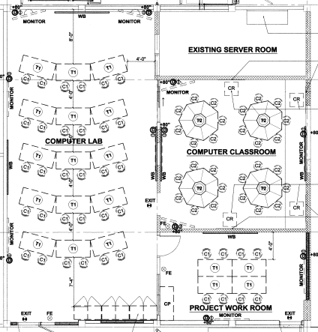
Aligning Facilities to the Pathway

Slide 7
Partnerships in and out of the legislature
Advocacy groups
HawaiiKidsCan
Code.org
Legislative branch
Senate Education Chair, Senator Michelle Kidani
House Education Chair, Representative Justin Woodson
House Finance Chair, Representative Sylvia Luke
Maui Economic Development Board
Executive branch
Department of Taxation
Office of Enterprise Technology Services
University of Hawaii System
Private partners
Queen’s Hospital System
Hawaiian Electric Company
Hawaiian Telcom
Department of Education
Paxca
Chamber of Commerce Hawaii
Hawaii P-20
University of Hawaii Community Colleges

Slide 8
Existing Programs Through Paxca

Slide 9
Legislative Achievements
Act 51, Session Laws of Hawaii 2018
Requires the Department of Education to develop and implement a statewide computer science curricula plan for public school students in K-12 that may include design thinking as part of the curricula and ensure each public high school offers at least 1 computer science course each school year
Appropriates $500,000 for the Department of Education to develop a plan for computer science implementation
CS Landscape Report of Hawaii Public Schools
Act 158, Session Laws of Hawaii 2021
Requires that all public and charter schools offer computer science by SY 2024-2025. Requires annual reports to the legislature
1st annual legislative report due in December 2021

Slide 10
New Goals
Create future pathways and certificate programs at community colleges
Geo-spatial analysis
Networking
Cloud and infrastructure
Cybersecurity
Data planning
IT planning and infrastructure
Intelligence
Provide funding for non-credit early college certificate classes and certificates including:
CompTIA
Cisco
GIAC
Oracle
Microsoft
Build out IT academies at high schools that feed into community college programs

Slide 11
Key takeaways from Hawaii’s experience
Introduction of new curriculum into public education system requires buy-in from school leadership and teachers
Create workforce partnerships and opportunities
Create partnerships with advocacy groups
Create partnerships with key legislators
Education Committee Chairs
Higher Education Committee Chairs
Appropriation Chairs
Fund facilities, programs, and positions to implement pathway and pipeline
Have a political plan to achieve your policy agenda

Slide 12
2022 Session Legislative Updates
SB3017 - Requires the Department of Labor and Industrial Relations to collect data relating to and necessary for development of a robust information technology workforce in Hawaii.
SB2928 - Establishes a working group to study and prepare an implementation plan for agricultural career pathways and report to the legislature.
SB2142 - Allows Department of Education students to fulfill world language, fine arts, or career and technical education graduation requirements with computer science. Establishes a scholarship at the University of Hawaii to encourage students majoring in education to take a computer science course. Requires UH to establish computer science pathways for students majoring in education. Requires teacher licensing and certification to include computer science. Appropriates funds.

