Slide 1
APRIL 30, 2022
APPLY ONLINE BY

Slide 2
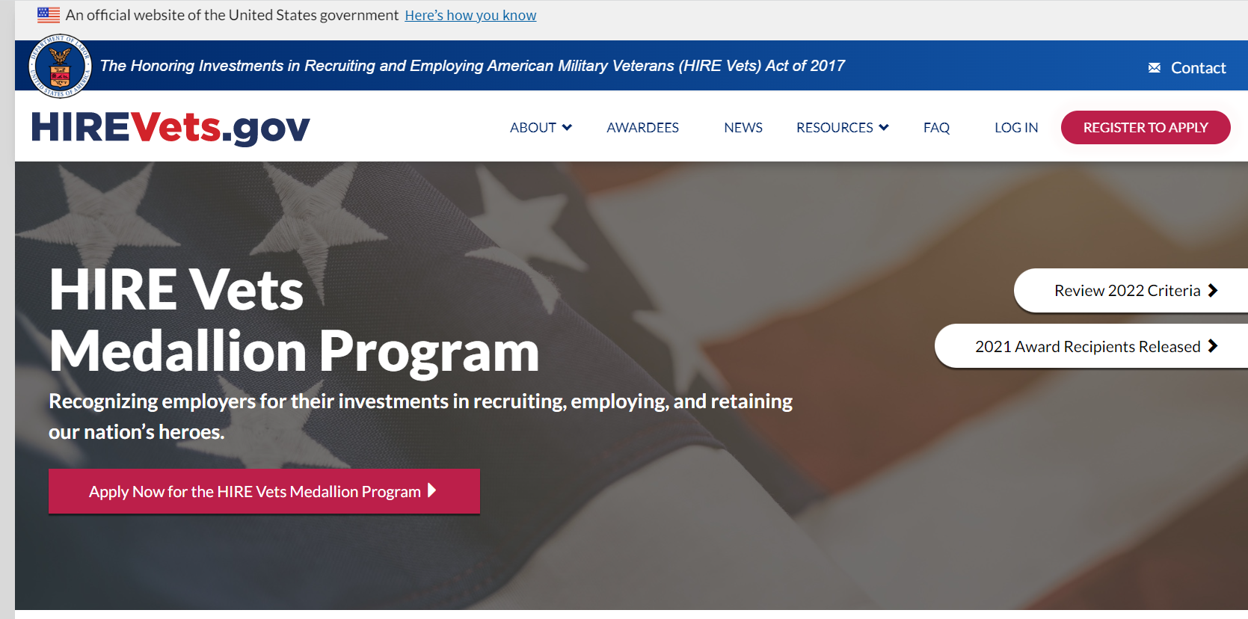

Slide 3
APRIL 30, 2022
APPLY ONLINE BY

Slide 4
2022 HIRE Vets Medallion Award Criteria
REQUIREMENTS
LARGE EMPLOYER AWARDS
(500+ Employees)
MEDIUM EMPLOYER AWARDS
(51-499 Employees)
SMALL EMPLOYER AWARDS
(1-50 Employees)
Platinum
Not less than 10% of employees hired AND
Not less than 85% of Vets hired retained for 12 months
Gold
Not less than 7% of employees hired AND
Not less than 75% of Vets hired retained for 12 months
Platinum
Not less than 10% of employees hired OR
Not less than 85% of Vets hired retained for 12 months
AND
At least 10% of employees are Vets
Gold
Not less than 7% of employees hired
OR
Not less than 75% of Vets hired retained for 12 months
AND
At least 7% of employees are Vets
Platinum
Not less than 10% of employees hired OR
Not less than 85% of Vets hired retained for 12 months
AND
At least 10% of employees are Vets
Gold
Not less than 7% of employees hired
OR
Not less than 75% of Vets hired retained for 12 months
AND
At least 7% of employees are Vets
Hiring
(Vets hired during CY 2021)
Retention
(Vets hired during CY 2020)
Veteran Employee Percentage (Vets employed on 31 Dec. of CY 2021)
N/A
N/A
INTEGRATION ASSISTANCE PROGRAMS
Veteran Organization or Resource Group (employer established) | Must be established and exist by 31 Dec. 2021 | Must be established and exist by 31 Dec. 2021 | Must be established and exist by 31 Dec. 2021 | Satisfy 1 of 2 | Satisfy 2 of 5 | N/A
Leadership Program | Must be established and exist by 31 Dec. 2021 | Must be established and exist by 31 Dec. 2021 | Must be established and exist by 31 Dec. 2021 |  |  | N/A
Dedicated HR Professional (large) or HR Veterans’ Initiative (medium/small) | Must be targeted to veteran employees | N/A | Satisfy 1 of 3 | N/A |  | N/A
Pay Differential Program | Must be provided | N/A |  | N/A |  | N/A
Tuition Assistance Program | Must be available | N/A |  | N/A |  | N/A
OTHER ITEMS
Labor Law Violations | Must not have any of the violations identified in 20 CFR § 1011.120 | Must not have any of the violations identified in 20 CFR § 1011.120 | Must not have any of the violations identified in 20 CFR § 1011.120 | Must not have any of the violations identified in 20 CFR § 1011.120 | Must not have any of the violations identified in 20 CFR § 1011.120 | Must not have any of the violations identified in 20 CFR § 1011.120
Application Fee | $495.00 | $495.00 | $190.00 | $190.00 | $90.00 | $90.00
¹ The above is a brief overview of the criteria needed to qualify to receive a HIRE Vets Medallion Award. For a detailed explanation, please visit HIREVets.gov and view the Final Rule for the program.
HIREVets.gov
Veterans Employment and Training Service UNITED STATES DEPARTMENT OF LABOR
Updated 7/2020

Slide 5
Hawaii’s Hire Vets Medallion Awardees
2021
Representative | Employer Name | Category | Award | City
Chels Chae (Owner) | Dynamic Planning & Response LLC | Small | Platinum | Honolulu
Charlie Alexander, HR Manager | Environet Inc | Small | Gold | Honolulu
Charlie Alexander, HR Manager | GSI Service Group Inc. | Medium | Gold | Honolulu

