Slide 1
DVR’s modifications to Hawaii’s Unified State Plan 2020-2023
The State Vocational Rehabilitation (VR) Services Program is authorized by the Rehabilitation Act of 1973 (Rehabilitation Act), as amended by Title IV of the Workforce Innovation and Opportunity Act (WIOA).

Slide 2
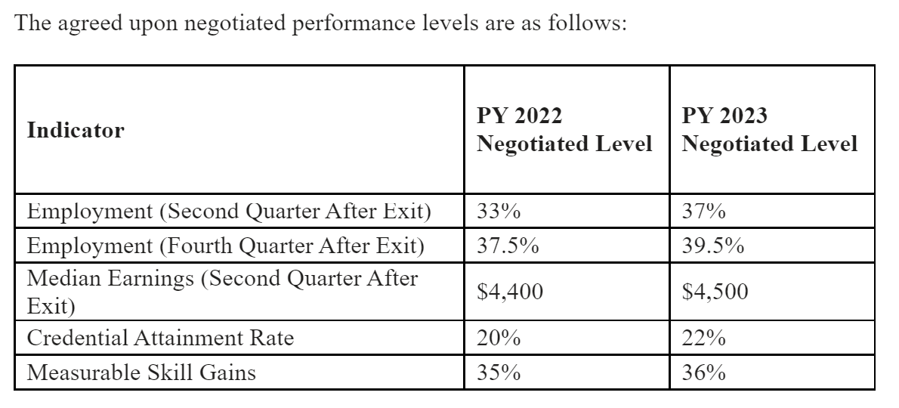
WIOA Performance Measures
DVR’s Modifications
Measurable Skills Gains Rates Increased From PY20 and PY21 Negotiated Rates as DVR exceeded expectations supporting clients to fulfill educational goals.
Rates for Median Earnings 2nd Quarter (6 months) after Exit negotiated for PY22-23
Employment Retention Rates for 2nd and 4th Quarter after exit negotiated for PY22-23
Credential Attainment Rates were negotiated for PY22-23 (measured post exit)

Slide 3
DVR’s Modifications: continued
Pre-Employment Transition Services for Students with Disabilities (SWD)
Increase % of SWD obtaining secondary and/or post-secondary credentials.
Increase % of SWD engaged in work-based learning experiences leading to sustained competitive integrated employment in Hawaii’s workforce.
Supported Employment Services for eligible individuals with most significant disabilities (MSD)
Increase % of VR participants with Supported Employment plans engaged in work-based learning experiences and internships that support sustained employment activities throughout DVR services and lead to the retention of competitive integrated employment by individuals with most significant disabilities.
Increase % of employers providing customized employment opportunities to DVR clients with MSD.
Employer Engagement
Increase employer engagement in hosting work-based learning experiences and internships leading to permanent employment opportunities in the workforce.
Increase the repeat/retention rates of employers providing DVR clients work-based learning, internships, and permanent employment opportunities statewide.
Share Common Data Collection standards and reports among WIOA Core Partners for evaluating workforce development initiatives.
Leverage the Employment First model to address workforce disparities for individuals with disabilities to be employed and compensated on par with their non-disabled peers.

Slide 4
Challenges
Areas remain under “Needs Correction” status that have to do with completion of a Triennial Comprehensive Statewide Needs Assessment (CSNA) for 2018-2020.
Hawaii DVR is currently working with San Diego State University to complete the CSNA for PYs 2018-2020, which was delayed by the pandemic and staffing shortages associated with the hiring freeze in 2020 ending July 2021.
DVR’s contract for the CSNA is currently being routed for signatures with an execution date of June 2022. Once the data is gathered from the CSNA covering the period 2018-2020, HDVR will work with the SRC and other stakeholders to address the findings in the CSNA and determine goals and strategies to address the rehabilitation and service needs of any identified minorities with most significant disabilities and identified in the CSNA. Recommended updates will be shared with DVR’s federal funder and State partners for integration into Hawaii’s USP 2020-2023 as applicable.

