Slide 1
Workforce Development Division Updates
Sector Strategies and Career Pathways Committee
August 4, 2022

Slide 2
Apprenticeship Program
State Apprenticeship Agency
State Apprenticeship Council

Slide 3
The Hawaii Carpenters Apprenticeship and Training Fund (June 4, 2022)
Plumbers and Pipefitters (July 9, 2022)
1 new program registered
As of July 12, 2022 there are 6,203 registered apprentices
461 apprentices became journeyworkers (July 1,2021-June 30, 2022)

Slide 4
Projects
Summer Youth
IT Internship
Sector Partnerships
RKT Media
Sector Strategies

Slide 5
2022 FINANCIAL LITERACY
Summer Youth Program
Purpose and Goal
To bring government agencies and selected DOE Title I high school students together for a pilot financial literacy summer youth work experience program where students had the opportunity to learn financial literacy and other work-related skills; and gain work meaningful experience to explore potential career paths.

Slide 6
2022 FINANCIAL LITERACY
Summer Youth Program
Total # of Youth Participants:
57
Island Breakdown:
Oahu: 39
Hawaii: 8
Maui: 9
Kauai: 1
Still in High School:
40
Enrolled/attending College or other post-secondary program:
10
Hired due to program participation:
5

Slide 7
Daetyn is a former participant of the Disability Employment Initiative (DEI) Program and was eager to sign up for this program. He credits his Teacher and father for encouraging him to apply for the program.
His parents credit the program for teaching him responsibility, initiative, and confidence. Thanks to his Work Experience and Supervisor at his worksite, Daetyn grew more comfortable conversing with other people and completing daily job tasks.
While his father was initially hesitant about the Financial Literacy workshops, it ended up being a great experience. Daetyn himself found it interesting and learned new concepts he uses even now that he's on vacation on Oahu. Asking himself, "Do I WANT this, or do I NEED this?" or whether he should save up for something else, when it comes to spending money.
When he returns home, Daetyn will be starting his new job as a Student Helper, a direct result of his participation in the program. Perhaps he'll save for a new set of golf clubs!
Daetyn

Slide 8
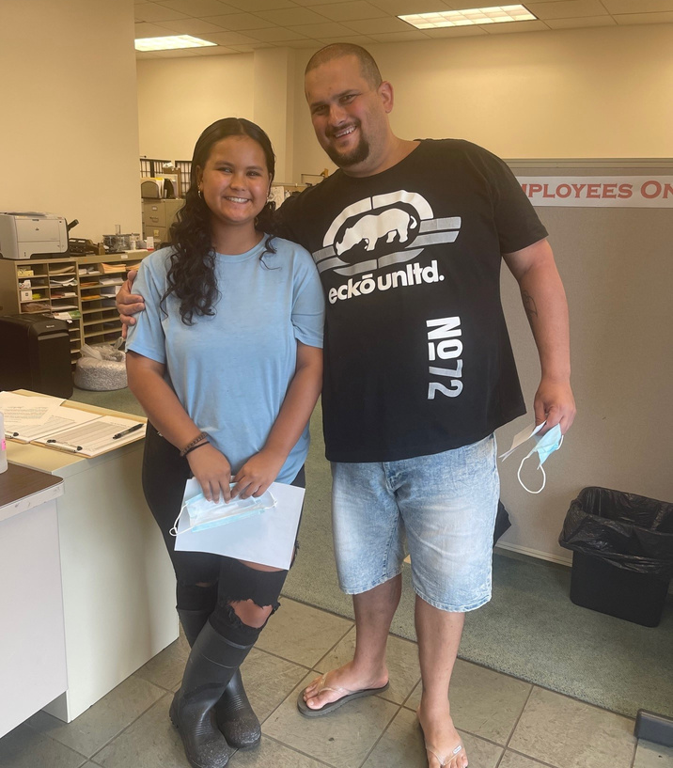
Recently graduated from Keaau High School. She was placed as a Custodian Helper for her work experience. Due to the work experience program, the school asked her to apply for an an on-call custodian position with the State of Hawaii DOE.
Jaiya will be earning $20 an hour when she gets called to work.
Jaiya

Slide 9
Lucille will be a senior this school year. After she graduates, she plans to attend college and is interested in Administration/Business.
She was also excited to have gotten the opportunity to meet Governor David Ige!
Lucille

Slide 10
Hilary is a recent high school graduate and had decided not to attend college. She completed the program; and has decided to attend college this spring semester.
Hilary realized that college would make a huge difference for her future.
Hilary

Slide 11
Justin will be a senior at Kailua High School next year. He participated at the Kaneohe Public Library for his work experience and was contributed 40 hours a week.
The head librarian was so impressed by Justin’s dedication and performance that she decided to hire him as a Year-Round Hawaii State Public Library System Student Helper.
Justin demonstrated a talent to persuade visiting patrons to explore the services available to the public, to have parents sign up their children for reading events. He also learned to set up the scenarios for the various reading events held at the library. Justin has contributed to his family tradition to contribute to the public library system.
Justin

Slide 12
Camille enjoyed her time with the Department of Health, Hazardous Waste section. She developed various skills such as excel.
Camille benefitted by participating in the Financial Literacy workshops, and even wished there could be more.
Camille

Slide 13
2022 INFORMATION TECHNOLOGY
Internship Program
Purpose and Goal
IT Internship:
To bring government agencies and recently graduated or soon to graduate students of an IT related degree or certification program together for a paid internship opportunity for...
Students to gain on the job IT experience; and
Build a skilled pool of candidates to meet the needs of any employer looking to hire qualified candidates with IT experience.

Slide 14
2022
Informational Technology
Internship Program
Total # of IT Interns:
40
All though this pilot program focused mainly on individuals that resided on Oahu, there was 1 Intern who was able to work remotely from Maui.
Still attending College or IT Certificate program:
23
Hired due to program participation:
8

Slide 15
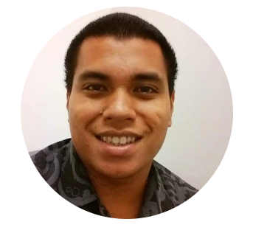
Micah completed his IT Internship at the Department of Human Services in the IT office. Micah impressed his supervisor and coworkers with his hard work and dedication. He played a critical role in helping the department with their inventory where he showed himself to be reliable, skillful, detail-oriented and accountable.
Micah was hired at Queen's Medical Center as a permanent full-time IT Support Analyst II.
Micah learned software programs during his internship that secured the position at Queen's Medical Center.
Micah

Slide 16
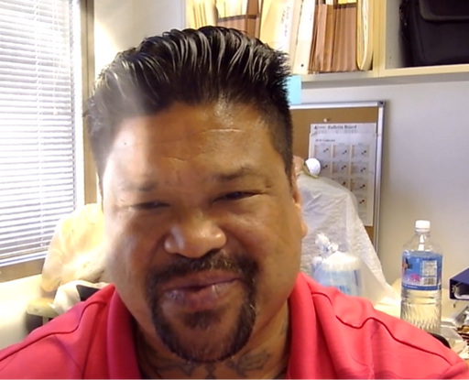
William enjoyed his IT Internship.
His supervisor and co-workers speak highly of him. He is currently volunteering with the Hawaii Ethics Commission and started an internship with Hawaiian Telcom which is focused on Cyber Security, Information Security, and Network Operations.
Will donates a large portion of his earnings towards several non-profits including schools.
Will is also concentrating on completing school. He is currently enrolled with Windward Community College where he is expected to graduate in the Spring of 2023 and is also attending Honolulu Community College where he expects to graduate in the Fall of 2024.
William

Slide 17
RKT Media
• Outreach and Recruitment Project
• $159,058.00
• Social Media Presence
• Youtube: 750,000-3.2 million impressions
• Facebook/Instagram: 1.400,000 audience 2.10,000-1.8 million daily reach (proposed audience would view ads almost 3 times in six months)
• Primetime Commercials

Slide 18
Chamber of Commerce Hawaii
• Hawaii Employer Sector Partnerships
• $119,658.82 • Four Sectors • Engineering
• 73 employers • Campbell, Castle & Waipahu School Complexes (14 Title 1 schools) • Engineers Week (11 events, 33 engineers, 500+ students)
• Healthcare • 80+ employers
• Farrington, Kapolei, Pearl City, Waianae School Complexes (22 Title 1 schools)
• Information Technology
• Increasing Internships • Build IT Job Board/Bank
• Maritime Industry • Focus on welding
• In partnership with Hawaii Defense Alliance

