Slide 1
HAWAI`I CLINICAL PLACEMENT COLLABORATIVE
Expanding to sister islands and allied health
Hawaii State Center for Nursing
September 1, 2022

Slide 2
Confirming clinical education is complex and arduous
Course 1
Section 1
Section 2
Course 2
Section 1
Course 4
Section 1
Section 3
Section 4
Placement 1
Placement 2
Alternate rotations
Placement 1
Placement 2
Alternate rotations
Section 2
Section 3
Section 4
Placement 1
Placement 2
Alternate rotations
Section 2
Section 3
Section 4
Access for Placements
Learning Objectives matched to unit
Health clearances for students (6) and instructor (1)
Unit Considerations
Other student training on unit
Nurse staffing on unit (number of nurses, availability of preceptors)
EHR for students (6) and instructor (1)
Nurse residents on unit
Patient number, illness severity and COVID status
Access for Schools
Each school has similar courses, each with multiple placement groups
Each school requires access within the same semester timelines (16 weeks)
Each school may schedule the clinical different day and times within the week

Slide 3
Managing Complexity Requires Strategy and Resources
Course
School 1
School 2
School 3
School 4
Section 1
Section 3
Section 2
Placement 1
Placement 2
Placement 3
Placement 1
Placement 2
Placement 3
Placement 1
Placement 2
Placement 3
Section 1
Placement 1
Placement 2
Placement 3
Section 2
Placement 1
Placement 2
Placement 3
Section 3
Placement 1
Placement 2
Placement 3
Section 1
Placement 1
Placement 2
Placement 3
Section 2
Placement 1
Placement 2
Placement 3
Section 3
Placement 1
Placement 2
Placement 3
Section 1
Placement 1
Placement 2
Placement 3
Section 2
Placement 1
Placement 2
Placement 3
Section 3
Placement 1
Placement 2
Placement 3
Facility 1
Facility 2
Facility 3
Facility 4

Slide 4
Complexity
primary and alternate clinical unit assignments
multiple placements
multiple training locations
unique constraints to access
Hawaii Board of Nursing, The Joint Commission and nursing education accreditation
unique EHR and health requirements for access to the facility
multiple schools
multiple courses
unique schedules

Slide 5
CURRENT ENVIRONMENT
Prevailing barriers to expanding healthcare education programs:
Too few clinical placements
Too few faculty
Barriers to facilitating current healthcare education:
Disorganized pathways to securing clinical placements
Lack of standardization across facilities, professions, and islands.
Duplication of work and human resources within schools and facilities.

Slide 6
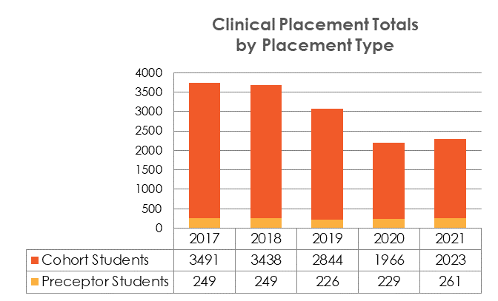
CURRENT ENVIRONMENT
Nursing – O`ahu and Kaua`i
Launched in 2012
Supports nursing education at all levels
Certificate (LPN)
Associate Degree (ADN RN)
Bachelor’s Degree (BSN, GEPN RN)
Master’s and Doctoral Degree (MS and DNP for Nurse Practitioner education)
Schools of Nursing - 8
Contributing Clinical Partners - 12
Supporting Clinical Partners - 30*
Enrolled Students: 1040^
Table: 2021 Clinical Placement Capacity Information Brief, retrieved from: https://www.hawaiicenterfornursing.org
*Supporting clinical partners varies by year. HSCN provides administrative support to supporting partners, which are small facilities with few clinical placements per semester
^Enrolled students vary by year.

Slide 7
CURRENT ENVIRONMENT
School’s Clinical Needs
Facility’s Training Capacity
Cross-
Partner Platform
Nursing – O`ahu and Kaua`i
Improves Efficiency:
Example: Processing of 4 Nurse Aide Students
Manual Entry= 20 hours of work
Coordinated Clinical Placements = <15 minutes
Improves Accuracy:
Enables facilities to coordinate student placements on units in an orderly and organized fashion and balance training commitments across the organization.
Enables standardized comprehensive reporting.
Improves Timeliness:
Maintains a schedule for securing placements before academic semesters begin to enable curricular planning, student admissions, and faculty resource planning, etc.
Increases Efficiency, Accuracy, and Timeliness of Clinical Placement Coordination

Slide 8
GOAL: Increase Healthcare Education Capacity
To expand support of nursing clinical placements across the state.
To apply the centralized and collaborative clinical placement model to allied health.
Image accessed through creative commons from: https://cdn.pixabay.com

Slide 9
Current
Onboarding and Phase 1 (January 1-June 30, 2023)
Nursing
O`ahu & Kaua`i
Phase 2 (July 1-December 31, 2023)
Onboard
Expand to Maui and Pilot Allied Health on Maui and O`ahu.
Establish allied health HCPC Workgroup.
Evaluate allied health cycle Implementation.
Phase 3 (January 1-December 31, 2024)
Nursing (continue)
Allied
Expand professions based on workforce demand needs.
Scale and sustain
Expand to additional islands and professions.

Slide 10
ACTIVITIES TO ACHIEVE GOAL
Establish HCPC Allied Health Workgroup
Contract new partners
Train new partners
Establish allied clinical placement cycle
Continue and expand nursing
Launch and test placement cycle for pilot professions
Establish framework to scale to additional professions and islands.
Scale to full list of identified professions and islands
Establish academic-practice sustained funding model
Onboarding
Phases 1 & 2
Sustainability

Slide 11
Human Resources to Support Success
Complexity
primary and alternate clinical unit assignments
multiple placements
multiple training locations
unique constraints to access
Hawaii Board of Nursing, The Joint Commission and nursing education accreditation
unique EHR and health requirements for access to the facility
multiple schools
multiple courses
unique schedules
0.15 FTE (Director; current staff, in kind)
Oversee strategy
Ensure partner buy-in
Facilitate MOU negotiation
0.6 FTE (Nursing Coordinator; current staff)
Maintain nursing efforts
Establish workplan. Train new staff.
Provide expertise on setting up collaborative
1.0 FTE (Allied Health Program Coordinator) – January 2023 start with continued effort
Onboard to program
Train new partners
Implement allied health collaborative workplan
Engage in training for new partners
Phase 3: Seek partner funding to sustain this role
1.0 FTE (Contracts and Data Support) - January –December 2023
Onboard to program
Train new partners
Support MOU and contracting efforts across islands and program types
Engage in data entry for clinical placements

Slide 12
PROPOSED BUDGET
 |  |  | Phase 1 (6mo) 1/1/23-6/30/23 | Phase 2 (6 mo) 7/1/23-12/31/23 | Phase 3 (CY) 1/1/24-12/31/24
Director | 0.15 FTE | In Kind | - | - | -
HCPC Program Coordinator | 0.6 FTE | Current Effort | - | - | -
Sister Island Program Staff 1 | 1.0 FTE | 62,000/yr + Fringe (53%) | $47,384.58 | $49,753.81 | $101,995.31
Sister Island Program Staff 2 | 1.0 FTE | 62,000/yr + Fringe (53%) | $47,384.58 | $49,753.81 | $0.00
CCPS Licenses | 10 | $1,000/yr | $10,000.00 | - | Partner Covers
Subtotal |  |  | $104,769.16 | $99,507.62 | $101,995.31
Indirect | 36.50% |  | $38,240.74 | $36,320.28 | $37,228.29
Total |  |  | $143,009.90 | $135,827.90 | $139,223.59

Slide 13
QUESTIONS?
Laura Reichhardt, MS, APRN, AGPCNP-BC (she/her)
Director, Hawai`i State Center for Nursing
LRNR@hawaii.edu
Office: 808-956-0524
Mobile: 808-341-0808
Brianne Atwood Kuwabara (she/her)
Program Coordinator, Hawai`i State Center for Nursing
Hawaii Clinical Placement Collaborative (HCPC) & The Hawaii Nurse Residency Program Collaborative (HNRP)
Mobile: (254) 654-5138

