Slide 1
Hawaii Federal Bonding
Sector Strategies and Career Pathways Committee Meeting
September 1, 2022

Slide 2
Background
On April 7, 2021, the United States Department of Labor awarded the Workforce Development Division (WDD) of the Department of Labor and Industrial Relations a Fidelity Bonding Demonstration Grant for $25,000
The period of performance for the grant is from April 7, 2021 to April 6, 2025 or until the grant funds are expended, whichever is earlier.

Slide 3
WHAT IS A FIDELITY BOND?
A fidelity bond is a form of insurance protection that covers the policy holder/employer for a loss caused by a one-time act of dishonesty (theft, forgery, larceny, and embezzlement) of a specific employee
An employer's risk for potential loss is most often covered with a $5,000 bond. The bond is issued for a six-month period, After the bond is issued, the bond is mailed directly to the employer
For the bond to be issued, the employer must make the applicant a job offer for a full-time job (40 hours per week) and set a date for the individual to start work. The bond becomes effective on the day the new hire starts the job

Slide 4
The bonds are issued in increments of $5,000 for a period of six months and the maximum amount is $25,000. $5,000 is generally sufficient to cover most circumstances.
This demonstration grant only covers the initial six months
After the end of six months, if no claim was paid, employers may request another six-month fidelity bond at regular commercial rates.
Bonds are not transferable from one employer to another.

Slide 5
Eligible Participants
Individuals who are unbondable through the regular commercial bonding system because of their criminal record, including those involved with the criminal justice system by virtue of their history of opioid or other drug addictions are eligible for coverage under the bonds purchased with these grant funds.
At least 18 years old
Must be paid wages
Federal taxes must be automatically deducted

Slide 6
Individuals are not required to be registered in Workforce Innovation and Opportunity Act (WIOA) programs
Employers who receive the bonds are not required to be registered on HireNet.

Slide 7
PROCEDURES
The bonds may be requested by one of Hawaii's American Job Centers (AJC), an AJC partner, an employer, or by an agency that provides job placement services to justice-involved job applicants.
To have bonds issued to an employer:
1. Fill-in the information on the "Requesting a Bond" form, Attachment 1.
2. Forward the form by e-mail or by U.S. Postal Service to:
Jarret Yip, State Bonding Coordinator
DLIR Workforce Development Division
830 Punchbowl Street, Room 329 Honolulu, HI 96813
E-mail: dlir. workforce.develop@hawaii.gov

Slide 9
How to Apply for WOTC in Hawaii
What is Work Opportunity Tax Credit (WOTC)?
A federal tax credit available to employers who hire job seekers from WOTC eligible target groups.

Slide 10
Work Opportunity Tax Credit (WOTC)
Employer: “How do I apply?”
BEGIN
1. Company’s Actions
Hires new employee – initiates Certification Request for the WOTC
2. Hawaii Dept of Labor
3. Company’s Actions
Filing the WOTC with the IRS
If submittal date is not 28 days or less following the employee’s start date, deny request
Company completes:
1. IRS Form 5884/5884-C
2. IRS form 3800, if required
3. Employer Certification (ETA Form 9063) is the supporting document for the credit.
COMPANY completes online:
1. IRS Form 8850,
2. ETA Form 9061, and
3. ETA Form 9175
Possible Outcomes
a. Certify request, emails company an Employer Certification (ETA Form 9063),
b. Deny request, emails Co. a letter of denial,
c. Delayed decision, supporting data/info is needed before a determination is made.
EMPLOYEE completes applicant section of 1) Form 8850, 2) Form 9061, and 3) Form 9175
IRS issues a business tax credit:
Tax credit amount depends on 3 factors: the target group of the employee, total hours worked, wages paid in first and/or second year of employment.
The maximum tax credit values range from $2,400 to $9,600 per eligible worker.
* Submit not later than the 28th calendar day after the date the employee begins working
* Apply at wotc.ehawaii.gov
** or fax: (808) 586-8822
** or mail forms to:
Hawaii Department of Labor
Attn: WOTC Coordinator
830 Punchbowl Street, Rm 329
Honolulu, HI 96813
Note 1: if none of the 7 items (1 thru 7) on page 1 of Form 8850 are applicable, do not submit you are not eligible
END
Final Note
To download forms and for a self-directed comprehensive overview go to: www.doleta.gov/business/incentives/opptax/
What is WOTC?
A federal tax credit available to employers who hire job seekers from WOTC eligible target groups.
** Will accept mail-in or fax applications. Online applications are processed faster.
Questions contact Mark Olds
WOTC Specialist, Hawaii Dept of Labor
Mark.N.Olds@hawaii.gov
rev. 5/11/2022

Slide 11
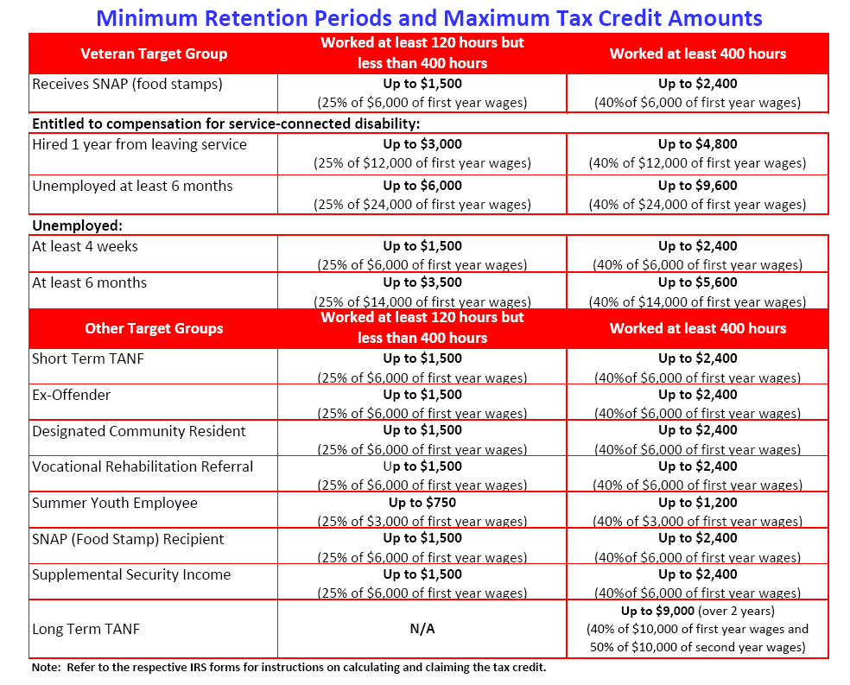

Slide 14
On-the-Job Training (OJT)
OJT is a great opportunity for employers to bring on new employees while reducing overall costs.
May qualify for 50% reimbursement of new employee’s wages during training period.
Access to large talent pool
Pre-screened candidates
Increase new employee’s skills while reducing training cost

