Slide 1
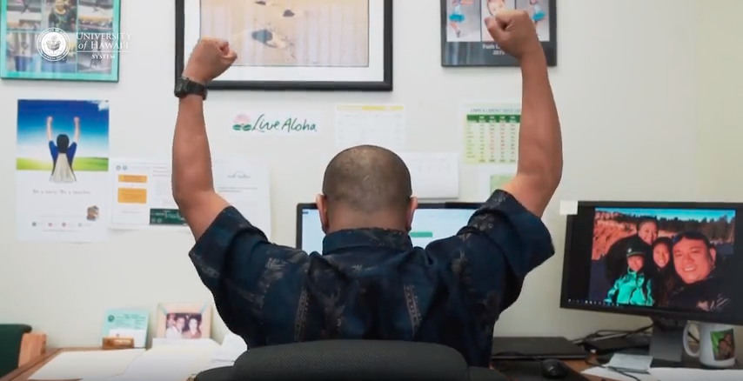
Teacher Licensure Programs

Slide 2
Employment/Shortage Data
Who gets hired each year?
How many positions are available?
Where is the highest need?
Access to the full employment report:
https://www.hawaiipublicschools.org/Reports/EmploymentReport2020-21.pdf
Notes:
Sometimes we get asked, “What is most needed? Where or in what are jobs available?” Although circumstances and needs can change year by year, the Hawaii DOE does issue an Employment Report, which outlines who got hired, how many positions were filled and where. The link shown will take you to the most recent Employment Report, however we have pulled out a few data pieces to share on the following slides.
Janet
To access the full employment report: https://www.hawaiipublicschools.org/Reports/EmploymentReport2020-21.pdf

Slide 3
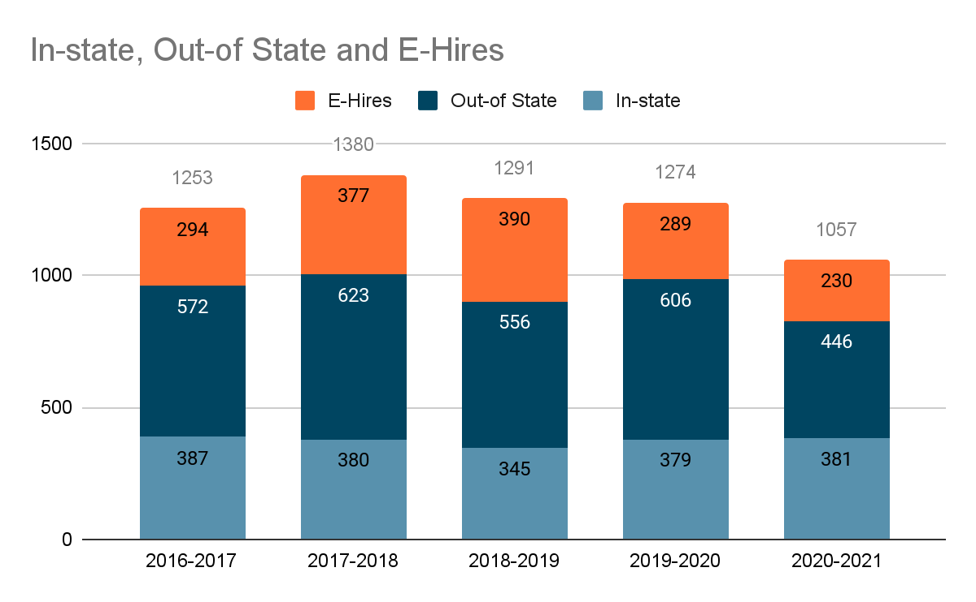
Teachers Hired Annually
The Hawaii DOE hires an average of 1,249 teachers each year, with an average of 30% licensed teachers produced in Hawaii!

Slide 4
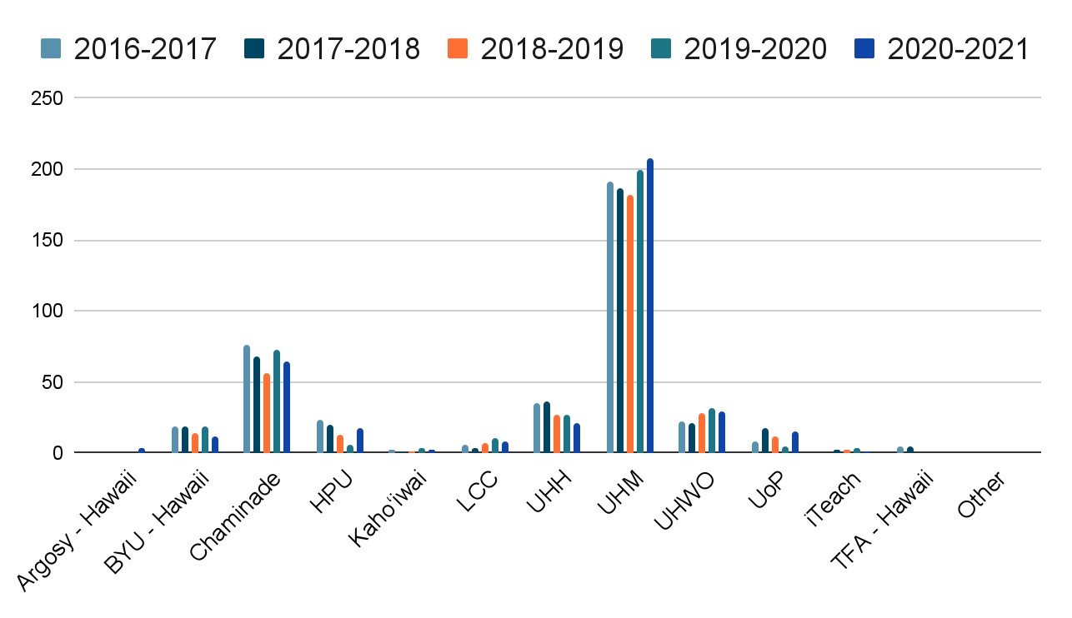
New Hires by SATEP Institution
Out of the 12+ Educator Preparation Program Agencies in the state, UH Mānoa produces about 53% of new in-state hires each year.
Notes:
Here at UH Manoa, we feel an incredible amount of commitment and responsibility in the field of teacher preparation, as we have been the largest producer of teachers for state each year.
However, with that being said, even if you took all the graduate from every Hawaii-based teacher preparation program, we are only filling about 25-35% of the positions being hired each year. This is why you will constantly hear about a teacher shortage in Hawaii. We currently do not have enough new teachers to fill the amount of positions needed each year.

Slide 5
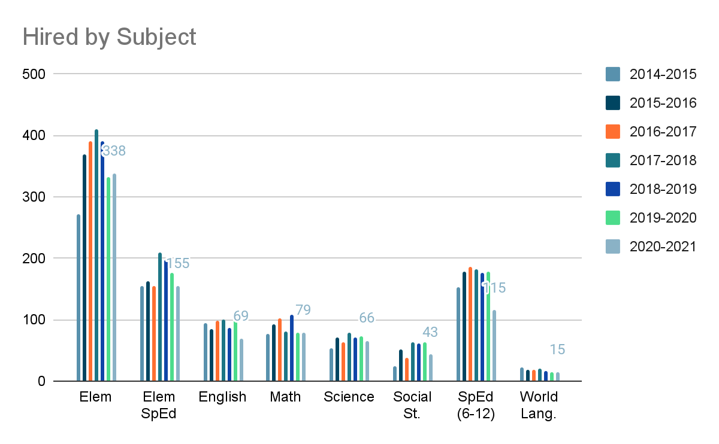
Employment Needs
Other positions include:
Art
Career & Technical Education
Counselor
English Language Learner
Hawaiian Immersion
Health
Music
Physical Education
ROTC
Notes:
The largest number of teachers hired each year are for elementary teaching positions, followed by elementary special education teachers. At the secondary level, the highest area of need is in special education, followed by Math, English, Science, Social Studies, and World Languages. There are a number of other subject areas available, which is shared on the full employment report, however the number of individuals hired into each would be less than 15 in a year.

Slide 6
Undergraduate Licensure Programs
For anyone wanting to earn their bachelor’s degree

Slide 7
Licensure Programs to Earn a Bachelor’s Degree (Final 2 years)
BEd Elementary
BEd Secondary (6-12)
07
Early Childhood + Early Childhood SPED (PK-3)
English Language Arts
Mathematics
Music
01
Science
Social Studies
World Language
Early Childhood + Elementary (PK-6)
02
BEd Special Education
Elementary (K-6)
08
03
Elementary + Hawaiian Language Immersion (K-6)
Secondary Mild/Moderate (6-12)
Severe Disabilities/Autism (PK-12)
04
Elementary + Multilingual Learners (MLL) (K-6)
BS Health & PE (K-12)
05
09
Elementary + Special Education (K-6)
06
Online/hybrid program, available on all islands

Slide 8
Office of Student Academic Services (OSAS)
Our Office of Student Academic Services provide career and academic advising support to all prospects interested in any of our teacher licensure programs.
Ask more specific questions
Get general advising
Learn next steps you can take
Discuss narrowing down program options
Application support
Learn how to set up an individualized one-to-one meeting with the advising office
Schedule appts:
Phone - (808) 956-7915
Email - osas@hawaii.edu
Online - tinyurl.com/educationkrsadvise
Advisors:
Denise Nakaoka, Director
Denise Abara, Associate Director
Alyssa Kapaona
Jolene Muneno

Slide 9
Associate Degree Pathways
Candidates who have completed an articulated A.A. degree from a UH Community College are considered to have met the UH-Mānoa General Education Core Requirements, with possible exceptions (see an academic advisor). Candidates who complete their associate degree first can transfer to UH-Manoa to complete their bachelor’s degree with licensure for either Elementary or Secondary programs.
Articulated programs in partnership with UH Manoa include:
AAT from Leeward Community College
AS in Human Services w/Early Childhood Specialization from Maui College
AA in Liberal Arts, Concentration in Education from Kapiolani Community College
AS in Early Childhood Education, Preschool Option from Honolulu Community College
AS in Early Childhood Education from Kauai Community College
AS in Early Childhood Education from Hawaii Community College
Please contact our Office of Student Academic Services (osas@hawaii.edu) for more detailed information.
To set up an advising appointment:
https://tinyurl.com/educationkrsadvise
Notes:
By designing our programs to be the final 2 years of the degree, that gives our candidates the option to attend a UH Community College for their first 2 years, to decrease costs of tuition.

Slide 10
Ka‘ie‘ie Transfer Program
Ka'ie'ie is a transfer program with the University of Hawai'i at Manoa (UHM). It is a dual-admission, dual-enrollment program for students who are pursuing a four-year undergraduate degree, but choose to begin their degree at Hawai'i CC, Honolulu CC, Kapi'olani CC, Kaua'i CC, Leeward CC, University of Hawai'i - Maui College, and/or Windward CC. It is focused on students successfully transferring from these UH system campuses to UHM while completing their academic degrees.
The main goals of Ka'ie'ie are:
Transfer smoothly and graduate with a Bachelor’s degree from UHM.
Provide mandatory advising and academic planning to students and connect them earlier to their major department at UHM.
Provide students the opportunity to take courses at one or both institutions while identifying the best time to transfer.

Slide 11
Important Features
Learn more about who we are
and what we offer

Slide 12
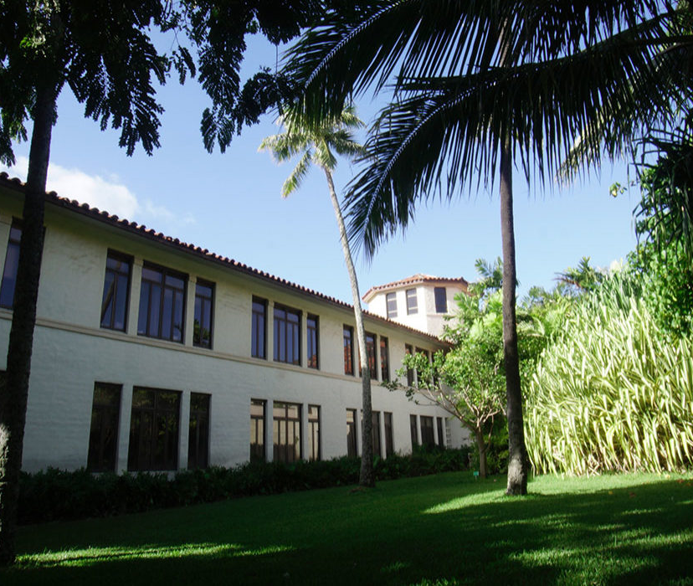
UHM College of Education
A Sense of Purpose.
A Sense of Place.
Preparing knowledgeable, effective, and caring educators to contribute to a just diverse and democratic society.

Slide 13
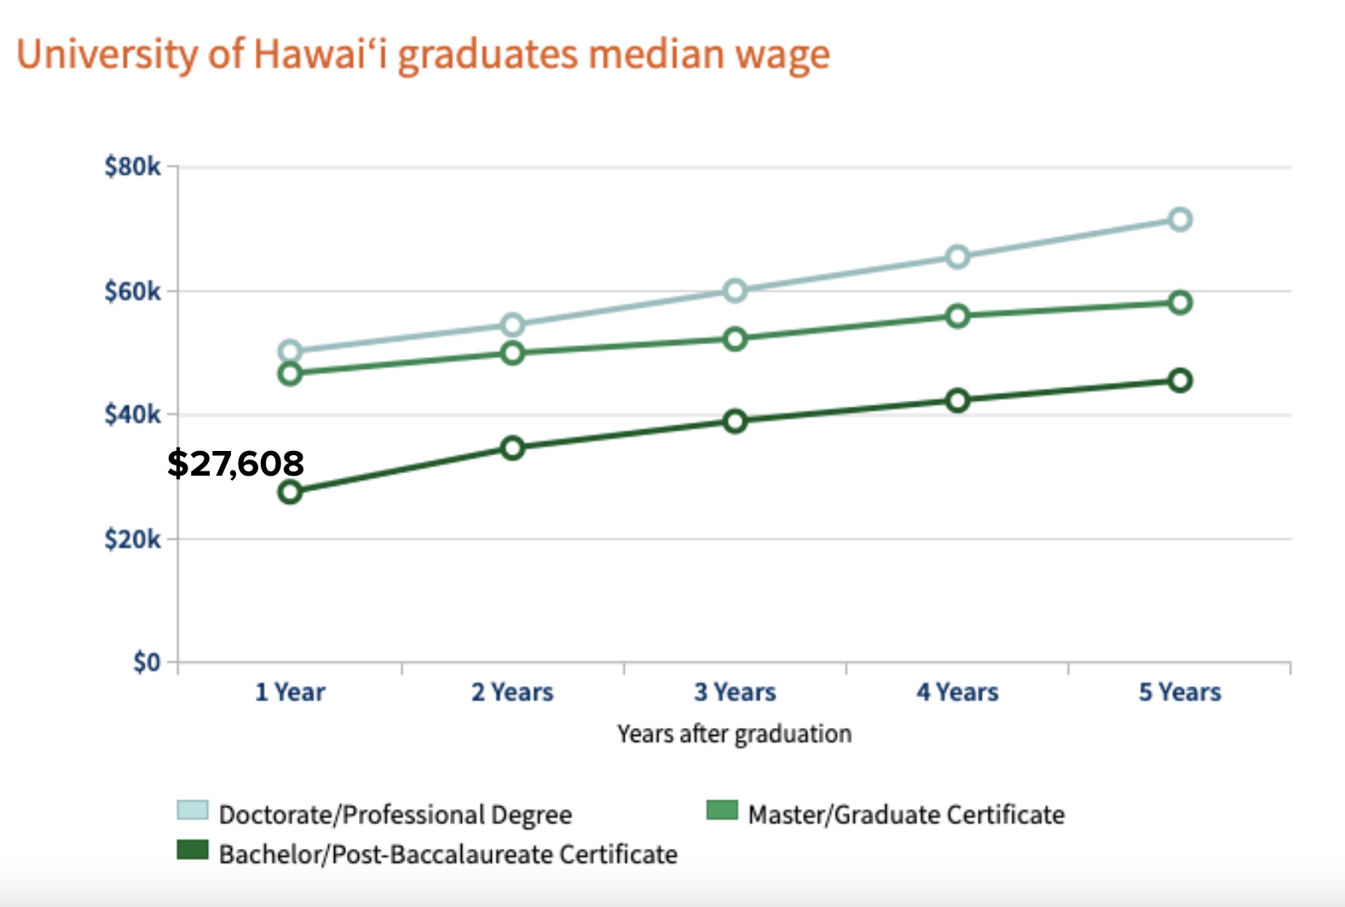
UHM Graduate Average Salary
Starting Teacher Salary = $49,100
Potential Teacher Salary = $91,948
10-month Employee

Slide 14
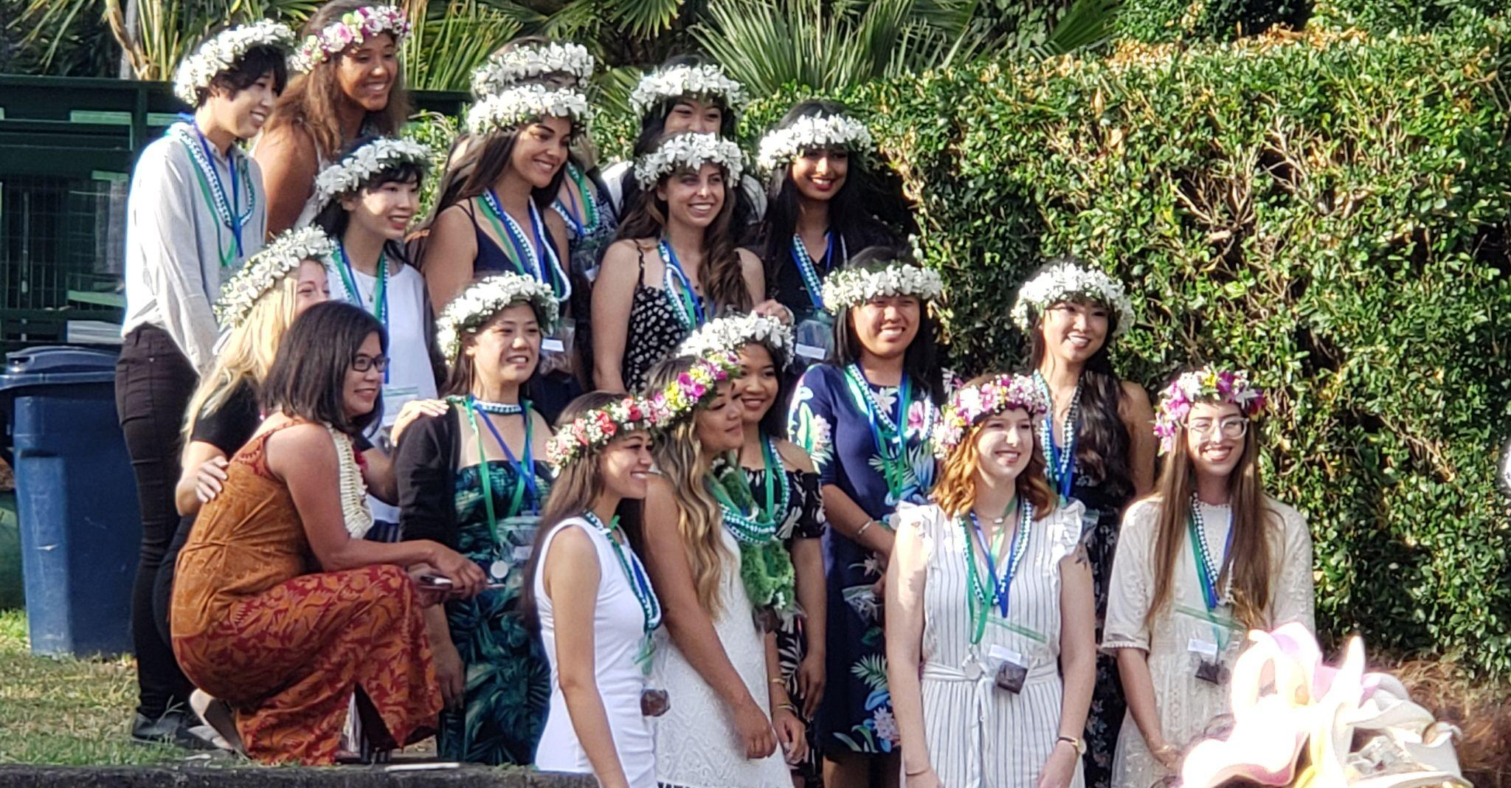
COHORT MODEL
COMMUNITY
SCHEDULE
SUCCESS
Members support each other like family.
Fixed course sequence and guaranteed classes.
Higher retention and graduation rates.

Slide 15
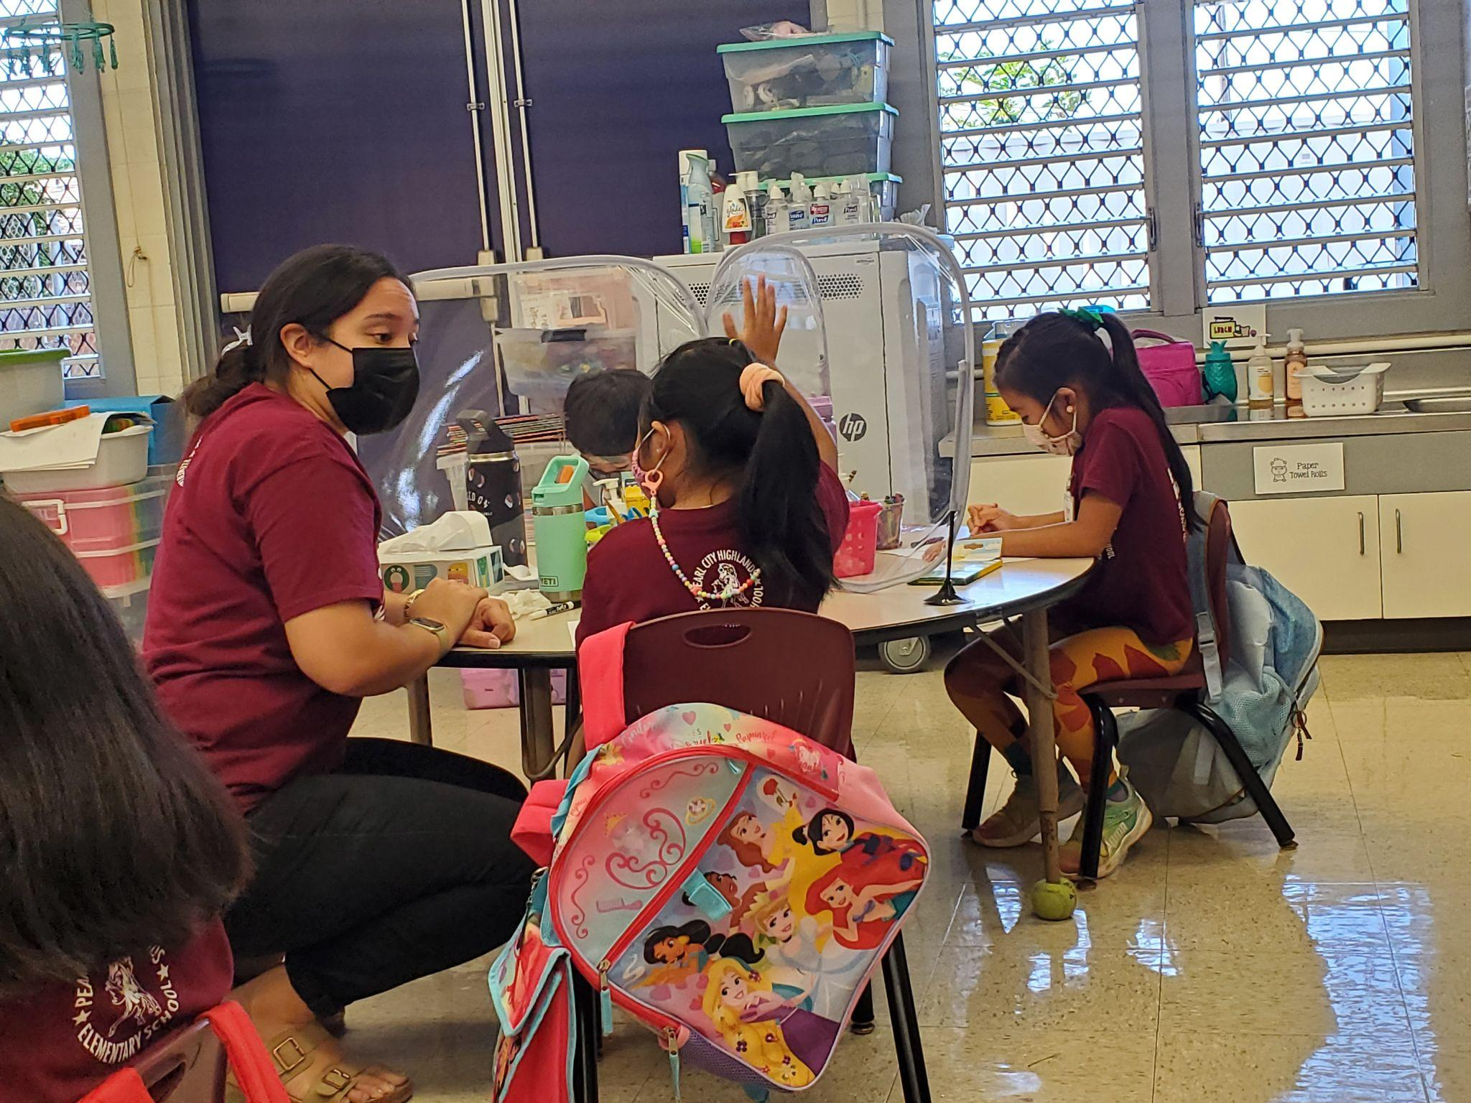
FIELD-BASED
MENTORSHIP
EXPERIENCE
READINESS
We place you in a real classroom with a mentor teacher.
Start with two days a week*, then full-time in student teaching.
Graduate ready to have your own classroom!

Slide 16
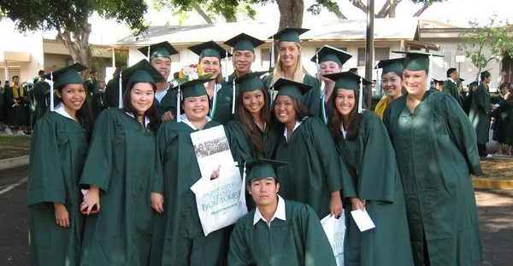
Dual Certification Options
BIGGEST BANG FOR YOUR BUCK
SPECIALIZED SKILL SETS
INCREASED EMPLOYABILITY
Two licenses in the same amount of time!
Learn skills to support a wider range of students and needs!
Can be hired in either field upon graduation!

Slide 17
Funding & Salary Info
Understanding all the opportunities and resources to support you on this journey

Slide 18
COST OF ATTENDANCE
‘20 - ’23
Resident Tuition | Undergraduate | $471/cr
 | Full Time Status For Manoa-based programs | $5,652 per semester
Non- Resident Tuition | Undergraduate | $1,389/cr
 | Full Time Status For Manoa-based programs | $16,668 per semester

Slide 19
Funding Supports
Federal Funding
Financial Aid, Grants, Loan Forgiveness
Scholarships
State Funding
Special Education HIDOE Tuition Stipends
Grow Our Own - Hawaiian Language Immersion

Slide 20
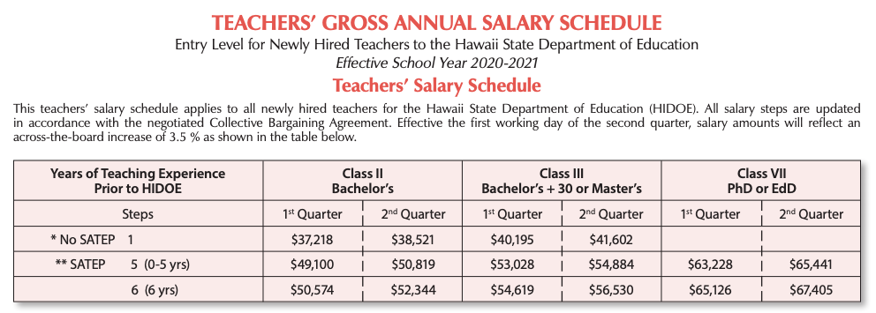
STARTING TEACHING SALARY
Hawaii Department of Education
From HI DOE Website:: Salary Schedule

Slide 21
RECLASSIFICATION SCHEDULE
Hawaii Department of Education,
SY 20-21
Professional Development
 | Class II | Class III | Class IV | Class V | Class VI | Class VII
Initial | BA | BA +30 or MA |  |  |  | Doctorate
Reclass |  | Class II + 15cr | Class III + 15cr | Class IV + 15cr | Class V + 15cr | Class VI + 15cr
Step 14B | $71,403 | $77,115 | $80,200 | $83,408 | $86,744 | $91,948
Step 14A | $67,361 | $72,750 | $75,661 | $78,686 | $81,835 | $86,743
Step 14 | $65,339 | $70,631 | $73,457 | $76,395 | $79,450 | $84,218
Yrs. of Service
From HSTA Website: https://drive.google.com/file/d/0B0JQ2SWs8fGfZGh5X1BiMkF5Z1U/view

Slide 22
Connect with Us!
We would love to connect and partner with Teacher Academies and other opportunities/agencies to engage and support students who may be interested in pursuing a teaching career!
Questions?
Special Education Recruitment Specialist
Janet Kim, spedinfo@hawaii.edu
bit.ly/spedinfo

