Slide 1
EMBRY RIDDLE AERONAUTICAL UNIVERSITY Jan 2023
Brief on the status of ERAU University with a focus on college programs and degrees available in Hawaii
For
State of Hawaii Workforce development Council - Sector Strategies & Career Pathway Committee
By
Dr. Linda Vee Weiland Program Coordinator Bachelor of Science in Aeronautics degree College of Aviation ERAU Worldwide
ERAU Locations
Headquarters is in Daytona Beach
Daytona Beach, Fl Campus https://daytonabeach.erau.edu/
Prescott, AZ Campus https://prescott.erau.edu/
Worldwide Campus https://worldwide.erau.edu/
Notes:
Thank you for the opportunity to share with my passion for aviation and my outlook on some ideas for Hawaii and aviation growth for our youth. My passion started an hour before birth when my mother went into labor on an Eastern Airlines plane flying from Detroit MI to Fort Lauderdale FL. I am names after the pilot…
Hawaii has a rich diverse background in aviation. https://www.facebook.com/HawaiiAviation/photos
I am Dr. Linda Vee Weiland and have been involved in aviation in Hawaii for over 30 years
My aviation occupations include
Air Traffic Control
Aerospace Maintenance officer
Major airline Liaison Engineer
Aviaiton Academia Professor
Military
Civilian
Academic

Slide 2
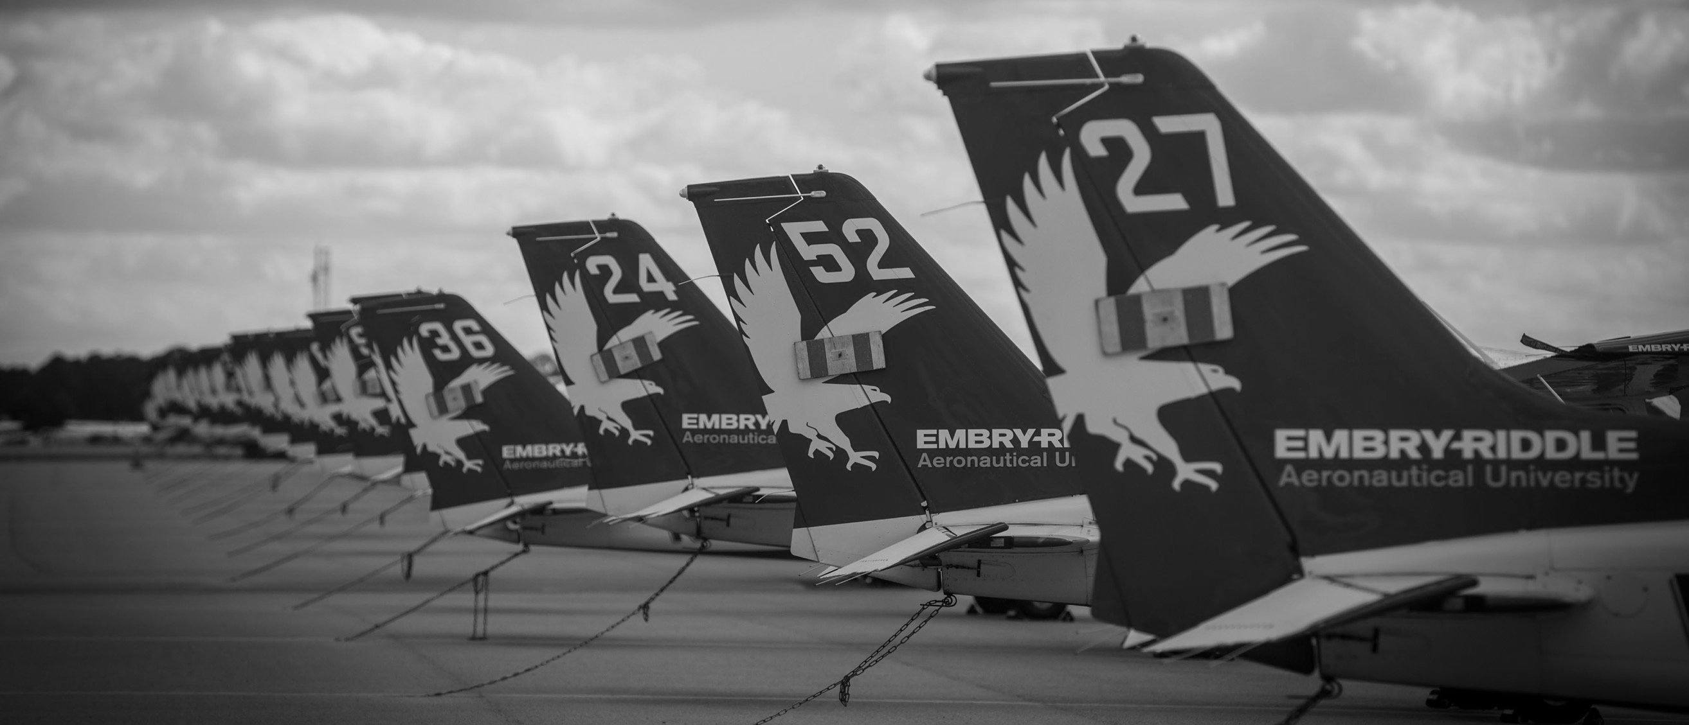
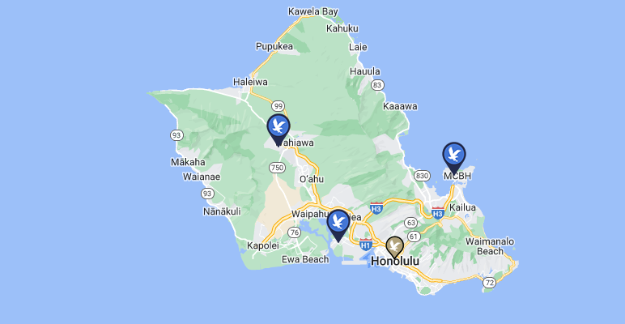
Worldwide | Oahu Jan 2023
https://worldwide.erau.edu/locations/schofield-barracks
https://worldwide.erau.edu/locations/honolulu
https://worldwide.erau.edu/locations/kaneohe
https://worldwide.erau.edu/online-learning

Slide 3
This is ERAU
Embry-Riddle offers a first-rate education to recent high school graduates, working adults, active service members, veterans, classroom students, and online learners.
The Embry-Riddle Aeronautical University we know today is the product of a long and prestigious history that started in Florida in 1925.
Now reaches globally with over 140 locations
Seven primary fields of study
Aviation
I will focus on this College from the Worldwide perspective and opportunities in Hawaii to attend classes with ERAU- Emphasis will be place on the Bachelor of Science in Aeronautics degree
Applied Sciences
Space
Business
Computers and Technology
Engineering
Safety, Security and Intelligence

Slide 4
ERAU Vision by Dr. P. Barry Butler 2022
Global Leadership
Continuous improvement to remain the leader in aviation aerospace higher education
Personal attention to student success
Goal to prepare students for a future in the aviation industry
Show students we care, wanted them excited and encourage to pursue goals and dreams
Prepare for meaningful careers, and experiential learning
Respected for innovation and research
Our recognitions and expansions in this are have grown significantly
Center for Aerospace Resilience
Center for Aviation and Aerospace Safety

Slide 5
College of Aviation | Worldwide Nov 3, 2022, information from Dean of COA Dr. K. Witcher

Slide 6
WHO WE ARE
78 employees 74 FTF (31% female)
415 +/- adjuncts
School of Engineering
2 Aero academic departments
Dept of Flight and Dept of Aviation English

Slide 7
Hawaiian Airlines Joins Embry-Riddle’s SkillBridge Program To Train, Employ Transitioning Military Personnel
The Aviation Maintenance Technology program is a nine-week, full-time program designed to train and place transitioning service members, honorably-discharged veterans and eligible military spouses into aviation maintenance and technician careers with reputable aerospace industry partners who are committed to hiring them.
https://worldwide.erau.edu/amtp
Hawaiian Airlines
https://news.erau.edu/headlines/hawaiian-airlines-joins-embry-riddles-skillbridge-program

Slide 8
WHAT WE DO
Support 12,991 students
21 academic programs
Taking 52,089 courses

Slide 9
Program updates
BSE awarded ABET accreditation (all engineering undergrad awarded ABET)
Master in Space Operations growth (329 applications in first year)
Master of Science in Aviation Safety (July 2022)
Master in Aviation Cybersecurity (July 2022)
BS in Pilot Operations (Jan 2023)

Slide 10
WORLDWIDE COA DOF PIONEERING OPERATIONS
Advanced Certifications
Multi-UAS Procedures Remote Split Operations
Industrial Inspection
Counter-UAS
Public Safety Training
Law Enforcement Active Shooter Response
Augmented Reality
Crime Scene Preservation and Forensics
Notes:
All photos from DOF operations. First organization in the world to be certified as training provider. First university, first pilots. Procedures for simultaneous operations, industrial inspection. C-UAS is picture of AeroScope

Slide 11
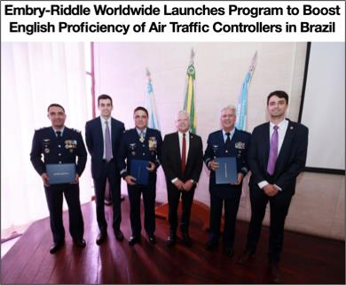
AVIATION ENGLISH TRAINING FOR BRAZIL
Department of Airspace Control (DECEA)
Four-year contract
English for Air Traffic Control Program
40-weeks
Online, asynchronous, instructor-facilitated
1,300 students
4 cohorts of 325 students/year
Conversation Partner Program – opportunity for Brazilian students to meet virtually for informal conversation with ERAU undergraduate students
Every year, the top 14 students will travel to Daytona Beach for specialized training

Slide 12
COA - Research
Research Products
AY 21-22
Growth in Full-Time
Faculty Scholarship Efforts
AY 2021/22
63 documents
57 presentations
AY 2020/21
53 documents
22 presentations
AY 2019/21
46 documents
53 presentations
76 FTF 2022
Training and Outreach Articles 31
72 FTF 2021
62 FTF 2020
Conference Presentation
26
Trade
Publication
25
55 FTF 2019
48 FTF 2018
44 FTF 2017
FY20
49 FTF 2014
41 FTF 2016
38 FTF 2015
Conference Proceeding
14
48 FTF 2013
Journal Article
13
Technical Report
4
AY 2012/13
18 documents
13 presentations
AY 2015/16
22 documents
17 presentations
Book
1
Book Chapter
2

Slide 13
International Journal of Aviation, Aeronautics, and Aerospace (IJAAA) AY 2021-22
Highlights:
IJAAA was recently accepted in both EBSCO and Cabells
In AY 21/22, we had 113 submissions (AY 20/21 Comparison: 112 submissions).
40 were accepted; 31 were academic articles, 9 were other submissions (concept papers, position papers, etc.).
Readership Distribution:
2021-22: 4,515 Institutions; 194 Countries, 1,513 Referrers
2020-21: 7,486; 206 Countries; 2, 654 Referrers

Slide 14
Bachelors of Science in Aeronautics
30+ Minors of study
Degree mapped to needs and demands of the industry
Classes are handpicked 7000+ students
Notes:
It’s a degree program mapped to the needs and demands of the industry with flexibility for work-life balance. It is designed specifically for student who work, have worked or desire to work in aviation.
This degree program has flexibility in awarding transfer credit from FAA certifications, military training and completion of prior courses.
The degree also has a broad base in aeronautical science and over 30 minors which allows students to tailor their degree to interests and career goals in aviation related fields. These areas include air traffic control, space studies, aviation safety, aviation maintenance, unmanned aerial systems, cybersecurity, and airport management.
Classes have been hand-picked to maximize the learning outcomes that will benefit you most and provide a straight and clear path to completion.
This degree program also carries the heart and prestige and respect in the aviation industry with the name Embry-Riddle, connecting you with our extensive professional and alumni networks.

Slide 15
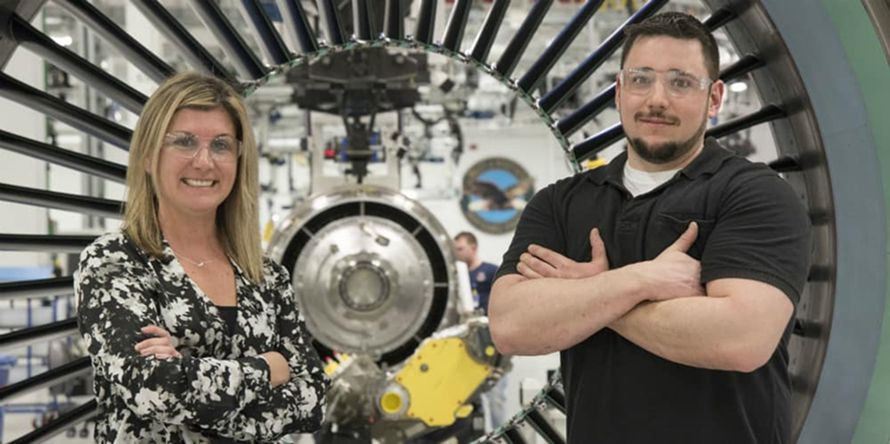
BSA Academic Snapshot
The Aeronautics degree is designed specifically for students who work, have worked, or desire to work in aviation-related careers, whether in fixed wing, rotary wing, air traffic control, or other areas of aviation.
Curriculum is closely mapped to the needs and demands of the aviation/aerospace industry
Multidisciplinary program with courses of study in human factors, security, aviation safety, occupational safety and health, air traffic control, aircraft maintenance and aeronautical science
Electives and minors allow students to tailor their degrees to particular interests and career goals

Slide 16
BSA Key Features
Strengths
Accredited – Aviation Accreditation Board International (AABI) and Southern Association of Colleges and schools (SACS)
Flexibility in learning modalities – global anywhere anytime
Faculty that is involved in the industry – real world application
Supported by exceptional adjunct instructors from around the globe
Course development is student focused – engaged learning experience
Relies on support from the ERAU Worldwide Industry Advisory Board
Notes:
Regardless of a student's physical location, whether overseas or deployed, students who have internet access can successfully complete the program.
addition to possessing academic credentials, have real-world industry experience. The subject-matter experience of our faculty results in linking course concepts to real-world application.

Slide 17
Learning Modalities
Traditional classroom
130 campus locations worldwide — from the U.S. to the UK to Turkey to Singapore
Online learning
Online classes require no commuting or sitting in a classroom, and students can set their own schedule
Classroom and Online blend
EagleVision Home, EagleVision Classroom, and the traditional classroom at one of our locations offer blended options
Eagle Vision
Virtual classroom that combines Web video conferencing and learning management system software to maximize the benefits of synchronous learning

Slide 18
Hands on Learning
Co-ops/internships
Practical experience learning
Field experience
Opportunities aid in bridging the gap between student life and the world of work by combining students’ academic and career interests with work experience in business, industry, government or service organizations
Enhances motivation and classroom participation by relating academics to the work world

Slide 19
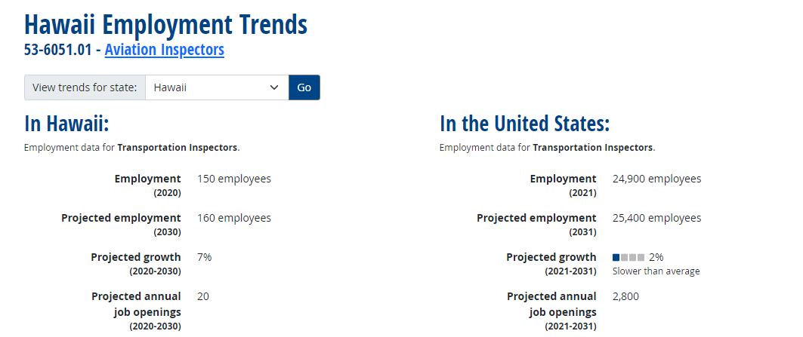
Careers
UAV Pilots/Helicopter Pilots/Aircraft Pilots
Air traffic Controllers
Aviation Investigator
Airport/Airline Manager/Director
Operations Manager/Director
Accident Investigation/Prevention
Aircraft Crew Member
Air Transportation Specialist
Aviation Maintenance
Aviation Safety
Aircraft Manufacturing
Avionics & Electronics
Consulting, Customer Service
Education/Instruction/Training
Ground Support Services
Management
Sales and Marketing
https://www.onetonline.org/link/localtrends/53-6051.01?st=HI

Slide 20
Top Employers
Regional and Major Airlines
Airports
Fixed Base Operators
Flight Schools
Government Agencies
Aerospace Industry
Air Services
Aircraft Manufacturers
Air Services
Consulting Firms
Corporate Flight Departments
Defense Contractors
Federal Research Labs
Helicopter Manufacturers
Insurance Companies
Manufacturing Industry
Multinational Corporations
Aviation jobs in Hawaii
https://www.avjobs.com/jobs/index.asp?ctry=United+States&s=HI
https://www.glassdoor.com/Job/hawaii-airline-jobs-SRCH_IL.0,6_IS1385_KO7,14.htm
https://www.indeed.com/q-Federal-Aviation-l-Hawaii-jobs.html?vjk=0d36e6dfc9aa09db
https://dod.hawaii.gov/hiang/join/careers/

Slide 21
Salary
US Bureau of Labor Statistics Economic News releases https://www.bls.gov/bls/newsrels.htm
General knowledge
Based upon data collected from ERAU's Office of Institutional Research in 2020, it was determined that:
The median annual salary for graduates who earn their BSA from Embry-Riddle is $77,000
Once bachelor level aviation professionals reach mid-level career, salaries typically show a marked increase of up to $100,000 annually depending upon title, industry and years of experience
The urgency of the hiring need can also help to increase salary expectations ​

Slide 22
Industry Needs/Job Forecasts
US BUREAU OF LABOR STATISTICS https://www.bls.gov/
Air Transportation https://www.bls.gov/iag/tgs/iag481.htm
As of Oct 2022, there were 553,866 employed in the Domestic Airlines industry https://www.ibisworld.com/industry-statistics/employment/domestic-airlines-united-states/
Industries provides air transportation of
Passengers
Cargo
Industries provides air transportation by
Airplanes
Helicopters https://www.bls.gov/oes/current/naics3_481000.htm

Slide 23
BSA Program Contact Information
Dr. Linda Vee Weiland Program Coordinator weila8f3@erau.edu
808-478-2156
Roth Britton
Associate Program Coordinator
Brittonr@erau.edu
386- 449-9676
ERAU Website
http://erau.edu/degrees/bachelor/aeronautics/
ERAU Catalog
http://catalog.erau.edu/worldwide/aeronautics/bachelors/aeronautics/

Slide 24
Questions?
In conclusion
Thank you for your time
I believe there is an opportunity to grow the aviation industry in Hawaii so that our children don’t have to move to the mainland to work or go to school
Dr. Linda Vee Weiland Program Coordinator weila8f3@erau.edu
808-478-2156

