Slide 1
Strengthening Equity and Diversity:
A Career Pathway for Interpreters and Translators
WDC Sector Strategies and Career Pathways Committee
February 2, 2023
Dina Yoshimi, Ph.D.
Director, Hawai‘i Language Roadmap,
College of Arts, Languages and Letters, UH-Mānoa

Slide 2
Our mission
“Change starts by understanding
the actual needs of the employers in the state - the businesses and government agencies dealing internationally as well as those interfacing with a multilingual domestic clientele and workforce.”
Implementation of the Hawai‘i Language Roadmap
Hawai‘i Language Roadmap Initiative Launch
Notes:
A pdf copy of the Hawai‘i Language Roadmap document can be found at:
http://nflrc.hawaii.edu/languageroadmap/wp-content/uploads/2013/09/HLRIfinalReport.pdf

Slide 3
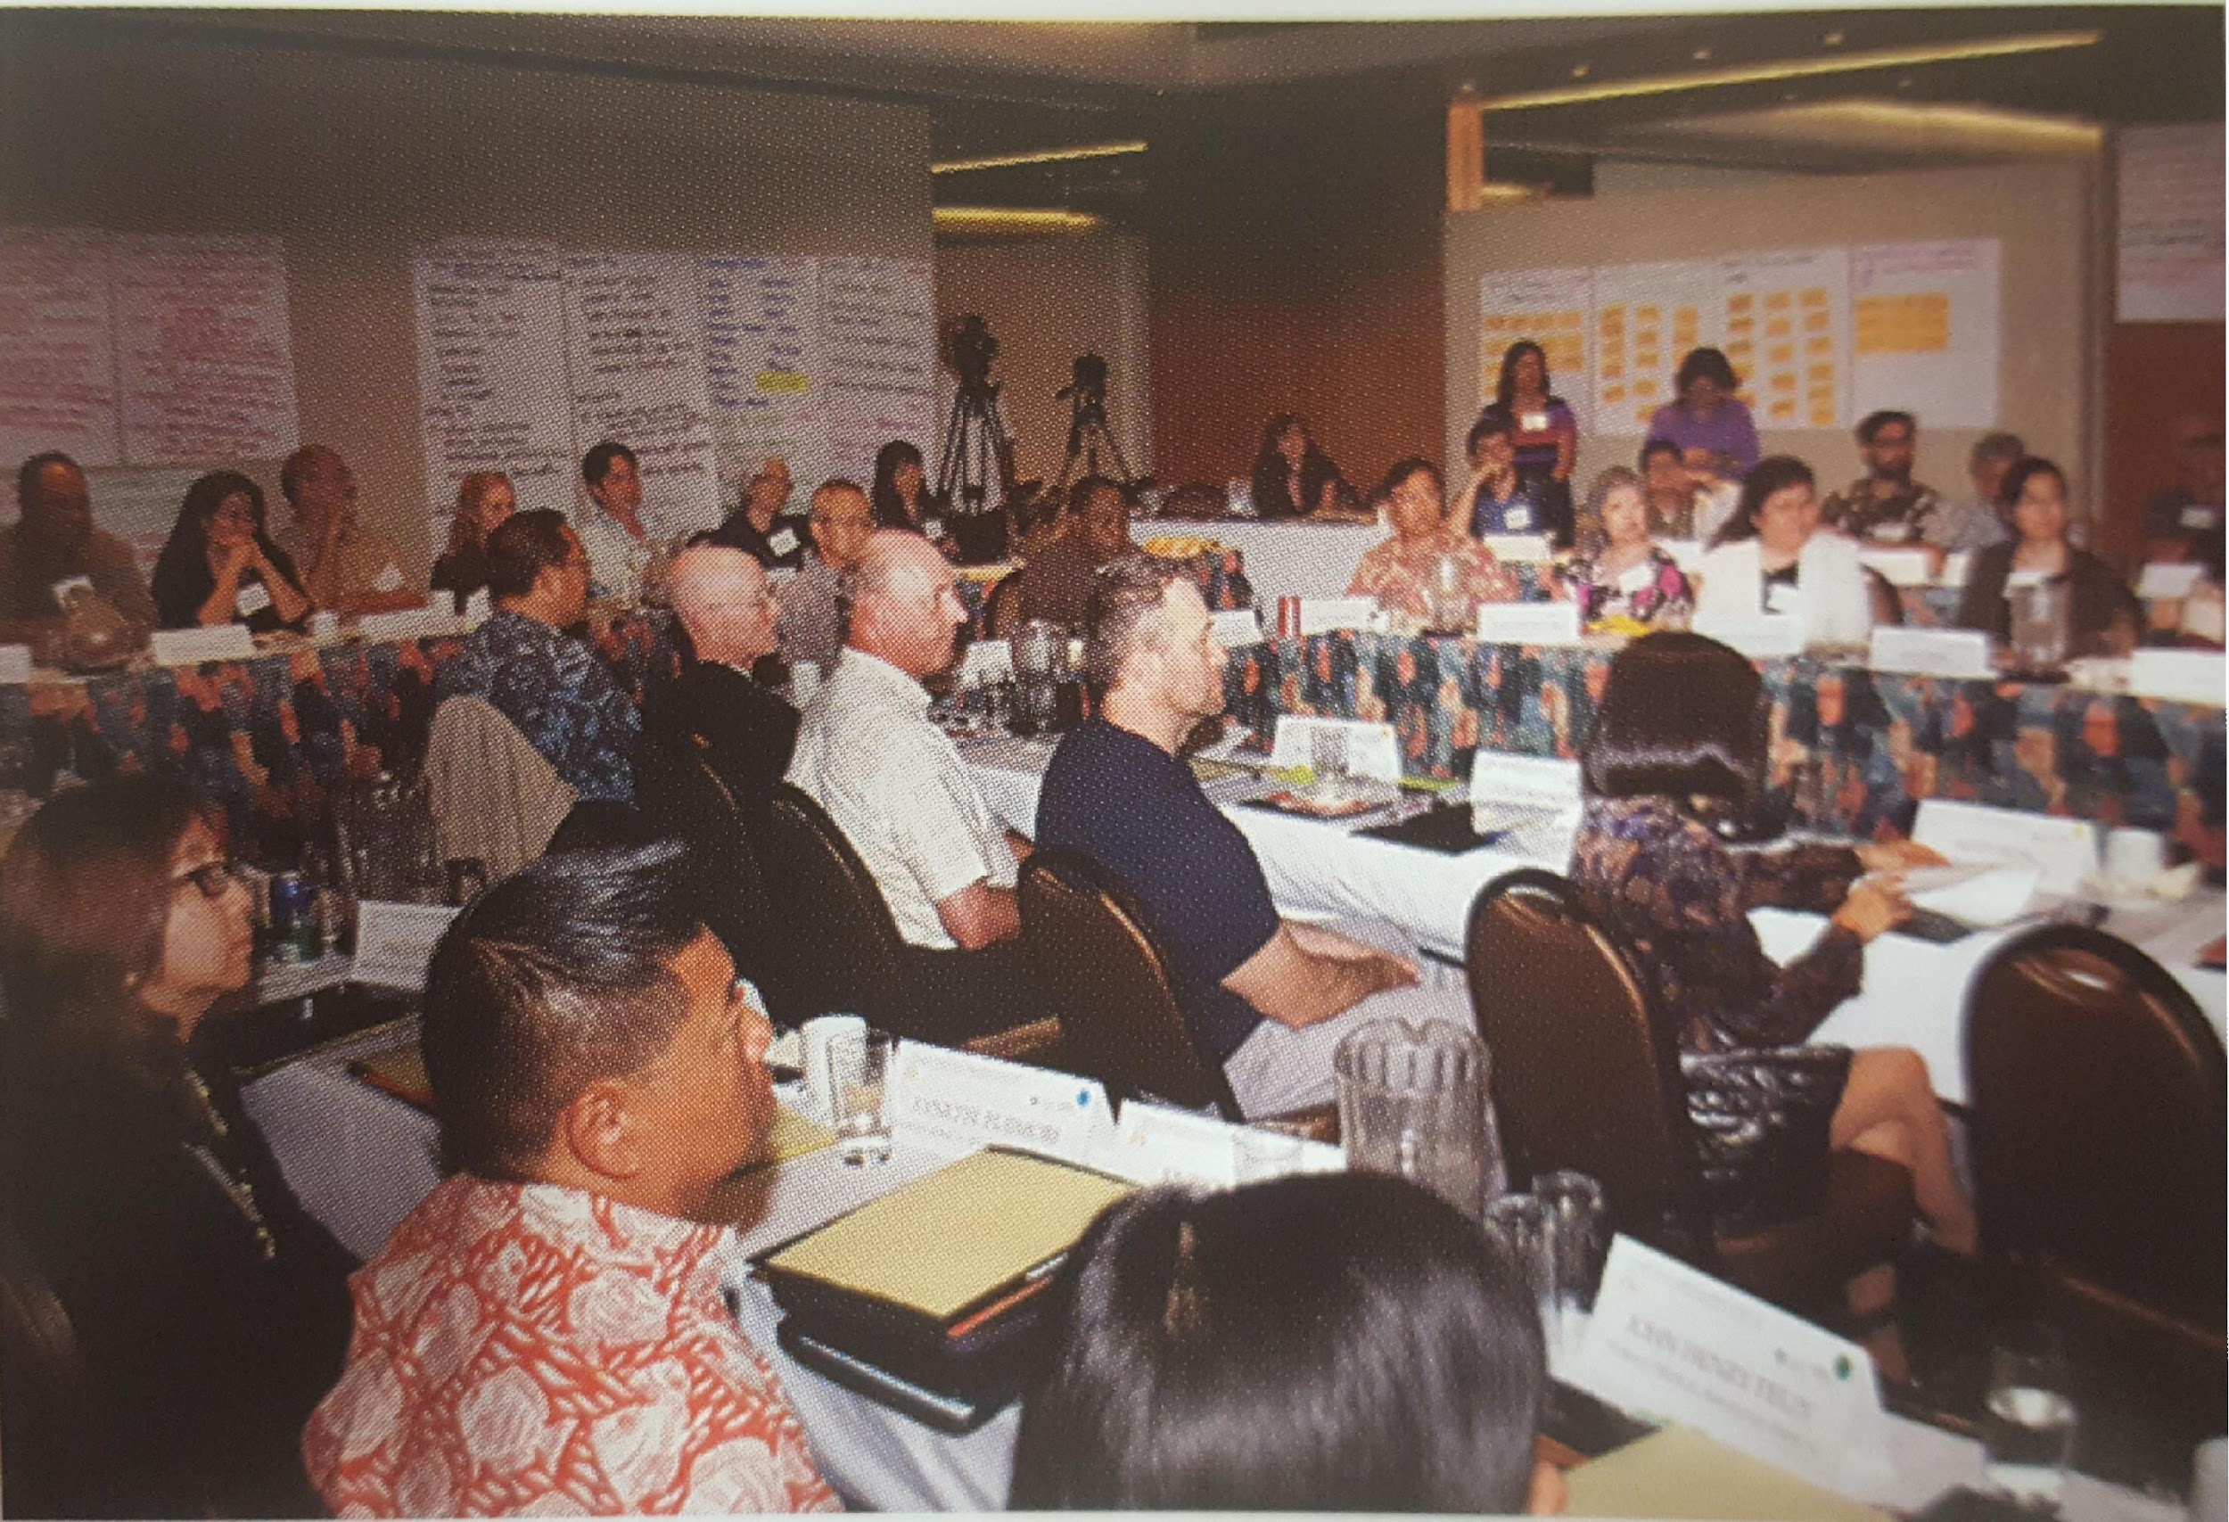
The Hawai‘i Language Roadmap: First steps
Hawai‘i Language Roadmap Initiative Summit
March
2013
Hawai‘i Language Roadmap Initiative Launch
September 2013
Notes:
Additional information can be found at: nflrc.hawaii.edu/languageroadmap
See also these videos: https://www.youtube.com/watch?v=kDuRG4RNHHE
https://www.youtube.com/watch?v=HRJtwVR59nQ

Slide 4
A Growing Demand in the Workforce: World Language Skills
Increasingly multilingual citizenry, including large immigrant and migrant populations
Visitor and convention industry
Local and global opportunities for economic growth
International trade, transportation and product localization
Climate refugees and persons displaced by war and natural disasters

Slide 5
The 8 Roadmap Initiatives
Create a coordinating entity for Roadmap implementation
Garner awareness of and engagement with Language Roadmap
Increase advocacy and leadership training
Create a database & web portal of language needs/resources
Create and implement the Hawai‘i World Language Initiative
Retain multilingual talent for key economic sectors
Improve interpretation & translation training/certification
Create jobs by branding Hawai’i as the place for multilingual talent
5

Slide 6
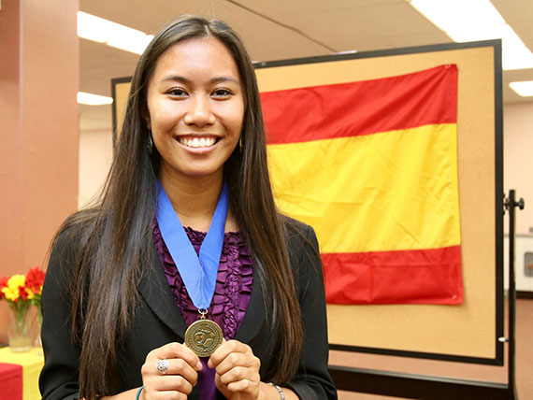
Initiative 5: Implement the Hawai‘i World Language Initiative - Hawai‘i Seal of Biliteracy
Source: Hawaii DOE | Seal of Biliteracy (hawaiipublicschools.org)
Notes:
More information about the Seal of Biliteracy can be found on the DOE website:
http://www.hawaiipublicschools.org/TeachingAndLearning/StudentLearning/GraduationRequirements/Pages/Seal-of-Biliteracy.aspx

Slide 7
The Hawai‘i Seal of Biliteracy BOE Policy 105.15
…to be awarded upon graduation to students who demonstrate a high proficiency in either of the State’s two official languages and at least one additional language, including American Sign Language…”
Rationale: “…there is personal, cultural, social, academic, and vocational/occupational value in encouraging students to maintain, or develop, proficiency in English and an additional language.”
Notes:
More information about the Seal of Biliteracy can be found on the DOE website:
http://www.hawaiipublicschools.org/TeachingAndLearning/StudentLearning/GraduationRequirements/Pages/Seal-of-Biliteracy.aspx

Slide 8
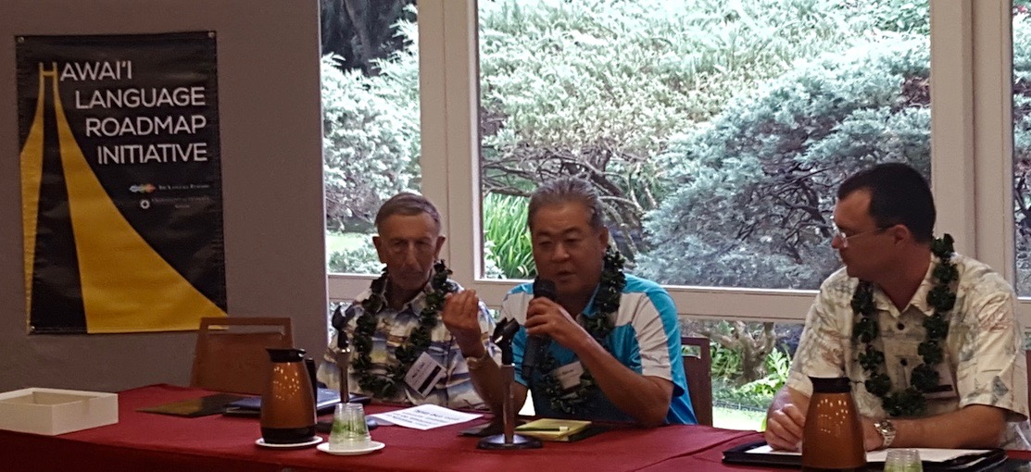
Partners for Publicizing the Seal
2nd Roadmap Symposium: The Seal of Biliteracy (2016)
Publicizing the Seal
Promoting awareness among policy makers, employers and leading community figures
Engaging educators
2nd Roadmap Symposium: Employer Panel
Peter Glick, Management & Consulting
Dean Okimoto, Nalo Farms
Niel Mason, Outriggergger)
Notes:
A video of this panel presentation is available on YouTube.: https://www.youtube.com/watch?v=o3rY_esftjM

Slide 9
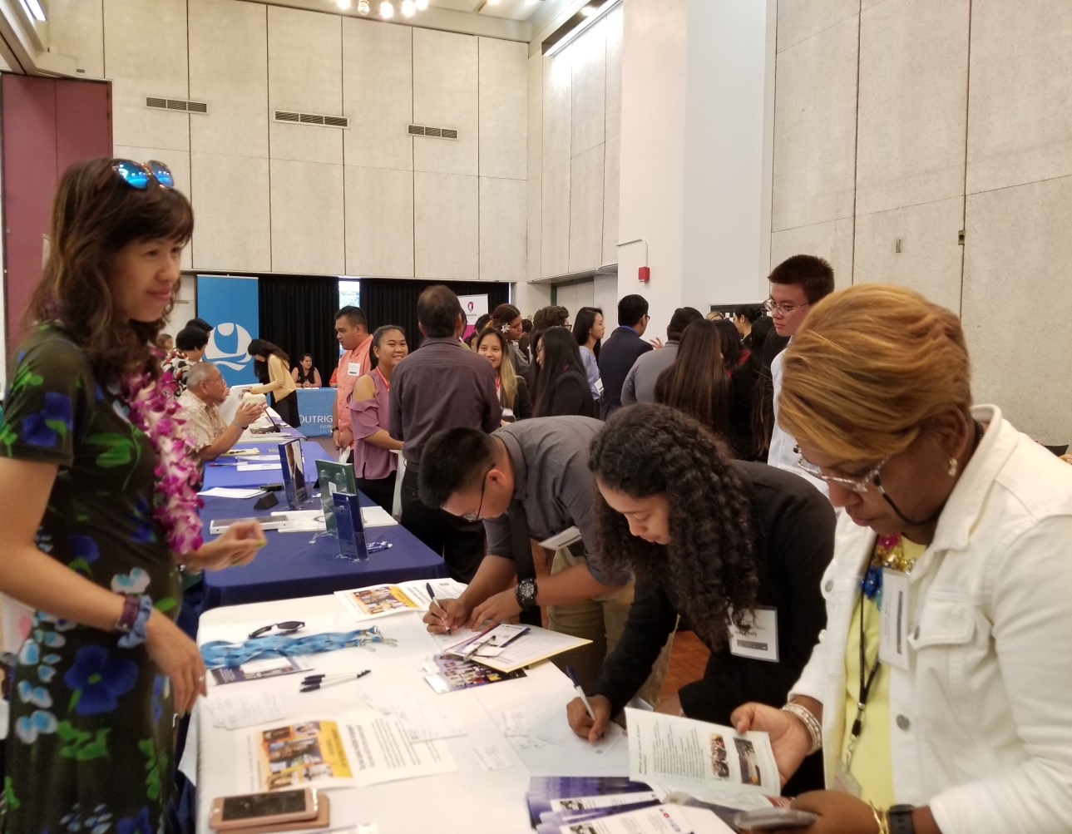
Multilingual Career Development Day (2018) Connecting Seal candidates to multilingual careers
Changed my mind about my future.
Found companies I would love to work for that I would never have thought of before!
Found interesting jobs that I never knew were out there.
Notes:
Hawai‘i Language Roadmap, in collaboration with the Hawai‘i DOE and co-sponsored by the State of Hawai‘i Office of Language Access
held the first Multilingual Career Development Day (which included a Multilingual Career Fair) on March 28, 2018. Student evaluations
included the comments presented on the right of the slide.

Slide 10
The Global Seal:
A new post-secondary option
A
Assessments available in over 100 languages

Slide 11
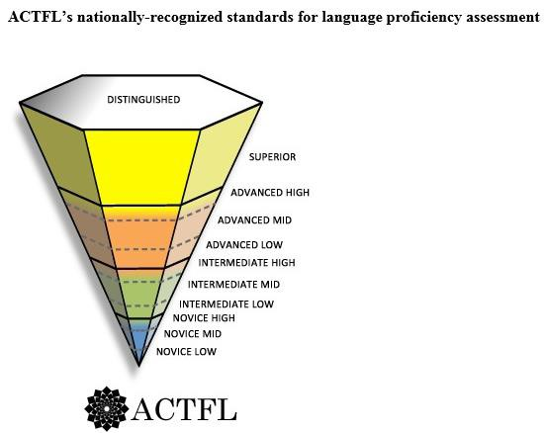
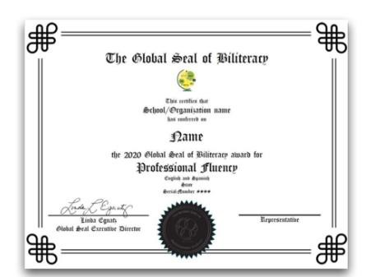
Top-tier Global Seal of Biliteracy

Slide 12
The US demand for interpreters and translators
(US Bureau of Labor Statistics)
Notes:
https://www.bls.gov/oes/current/oes273091.htm

Slide 13
Demand for interpreters and translators in HI
(US Bureau of Labor Statistics)
Employment of interpreters and translators
Number employed (50-220)
State-specific figure provided: 50
Annual mean wage (May 2021): $45,520-$50,450
These are incomplete statistics: Many employees are called upon to interpret or translate, even when it is not part of their job description. Moreover, bilinguals across workforce sectors know that the demand for interpreters and translators far exceeds the supply, resulting in them regularly being “recruited” to handle mundane and high stakes interactions. THIS IS A VIOLATION OF THE FEDERAL CIVIL RIGHTS LAW.
Notes:
https://www.bls.gov/oes/current/oes273091.htm

Slide 14
US Civil Rights law concerning discrimination by national origin and implementation
Title VI of the Civil Rights Act of 1964:
Non-discrimination in federally-assisted programs. Prohibits discrimination by national origin.
Executive Order 13166 of August 11, 2000 Improving Access to Services for Persons with LEP. The Federal Government is committed to improving the accessibility of these services to eligible LEP persons.
US AG’s Memorandum of November 21, 2022
“…there remains a clear need to further enhance access to multilingual information.”
Notes:
Federal Language Access Regulations which aid agencies in the implementation of Title VI of the Civil Rights Act of 1964, regarding prohibition against national origin discrimination affecting LEP persons.

Slide 15
Hawai‘i’s Language Access Law Language Access to State services (2006)
HRS 321C, the state’s Language Access law, ensures that individuals who identify themselves as having limited English proficiency (LEP) will be provided meaningful access to state-funded services.
Requirements for state agencies, and covered entities receiving state-funding include:
preparing and following a Language Access plan to provide services to LEP clients;
providing timely and competent oral interpreting services;
providing translations of vital documents; and
providing other reasonable accommodations.
Retrieved from: http://health.hawaii.gov/ola/what-is-the-law/
Notes:
Federal Language Access Regulations which aid agencies in the implementation of Title VI of the Civil Rights Act of 1964, regarding prohibition against national origin discrimination affecting LEP persons.

Slide 16
Hawai‘i State Judiciary Court interpreter Certification Program (2015)
The Hawai’i State Judiciary has a Court Interpreter Certification Program that aims to expand and improve the Judiciary’s pool of qualified interpreters through screening, training, and testing.
Increased efforts to recruit and train Hawaiian language interpreters began in 2018 in an effort to support Hawaiian language and culture, i.e., to supply those who wish to express themselves in Hawaiian in court with the means to do so.
(Hawai‘i State Judiciary Annual Report 2018 pp 33-36)
Notes:
annually provides interpreters for over 10,000 court proceedings; Interpreter program has over 400 interpreters speaking over 50 languages

Slide 17
Hawai‘i State Judiciary Demand for Court interpreters
The Hawai’i State Judiciary court interpreter program has over 400 interpreters speaking over 50 languages on its roster.
Interpreters are provided for over 10,000 court proceedings annually.
There are 6 payment tiers from $25-$55/hour (plus mileage reimbursement) per the interpreter’s qualifications
Components of Certification 12-08-05 (state.hi.us)
Notes:
annually provides interpreters for over 10,000 court proceedings; Interpreter program has over 400 interpreters speaking over 50 languages

Slide 18
Next-step career opportunity Bilingual attorneys and legal assistants
Notes:
Preferred but not required.
Specialist Social Media – Hawaiian Air
Specialist – Central Pacific Bank
Sales rep – Anheuser Busch

Slide 19
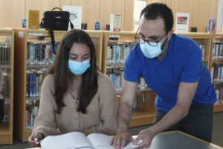
The vision
“I said, ‘This would be amazing for our kids,’” Pimentel recalled.
She said some students who spoke Portuguese at home resisted studying it when they came to school because they didn’t see the value.
“I thought that this would be a way for them to see how their skills can be used immediately after graduation in real life and make money,” Pimentel said.
Implementation of the Hawai‘i Language Roadmap
Hawai‘i Language Roadmap Initiative Launch
Notes:
A pdf copy of the Hawai‘i Language Roadmap document can be found at:
http://nflrc.hawaii.edu/languageroadmap/wp-content/uploads/2013/09/HLRIfinalReport.pdf

Slide 20
Demand for interpreters and translators in HI
Employer: State of Hawai‘i DOE
Bilingual/Bicultural School/Home Assistant (Tagalog/Ilocano)
Oahu Island, HI
$3,160 a month - Full-time, Part-time, Temporary
Job Summary: Serves as liaison between school and project staff and target group parents; provides language and cultural assistance; and performs other duties as required.
General Experience Requirement: Two (2) years of paid or volunteer work experience in which the applicant worked with individuals and groups and was required to possess the following ability or demonstrated same:
Understand and explain various materials related to the program/project/activity.
Establish and maintain rapport with individuals and groups and encourage participation in program/project activities.
Speak effectively with individuals and groups and to elicit pertinent information.
Plan and conduct group information sessions.
Prepare activity reports.
Recognize and identify basic individual human needs.
Notes:
https://www.bls.gov/oes/current/oes273091.htm And Paraprofessional educator

Slide 21
Demand for interpreters and translators in HI
Employer: Queen’s Health System
Job Title: Clinical Navigator, Oncology Posted: 2022-01-25
I. JOB SUMMARY/RESPONSIBILITIES
Responsible for the coordination of patient care throughout the continuum in collaboration with all healthcare providers and the multidisciplinary care team to provide seamless process for oncology patients. Serves as an advocate, interpreter, educator and clinical resource with expertise in medical, surgical, and radiation oncology and care management. Serves as a liaison throughout the facility and in the community regarding services provided for this unique patient population. Coordinates all aspects of the perspective treatment plan regimen.
Notes:
https://uhcc.hawaii.edu/career_explorer/skills/search_skill.php?t=light&s=Multilingualism And MIMI LIND (Intake for mental health); Bayada for Behavioral health for ELs.

Slide 22
Other employers: Health and social services
Community Health Worker (UnitedHealth Group, Inc)
Bilingual English / Tagalog or Ilocano or Marshallese or Chuukese (Preferred)
Social Work Case Manager
(Partners in Development Foundation)
two (2) years of experience in working with culturally diverse population, especially with natives from the Micronesian nations; Proficient in Chuukese, Kosraean, and English
Notes:
https://uhcc.hawaii.edu/career_explorer/skills/search_skill.php?t=light&s=Multilingualism

Slide 23
What does a T/I Pathway look like?
Two years, four courses
Course content:
Ethics
Basic skills
Simultaneous interpreting (shadowing)
Consecutive interpreting (note-taking)
Medical/Legal/Specialist vocabulary
Professionalism
Exit test with option for certification
Notes:
annually provides interpreters for over 10,000 court proceedings; Interpreter program has over 400 interpreters speaking over 50 languages

Slide 24
Building a T/I Career Pathway
Develop curriculum
Use or modify an existing curriculum
Develop a new curriculum
Train teachers (2 per program)
Proficient in the focal language
Long-term commitment to the program
Train language coaches
"expert speakers"
committed to student support
Notes:
annually provides interpreters for over 10,000 court proceedings; Interpreter program has over 400 interpreters speaking over 50 languages

Slide 25
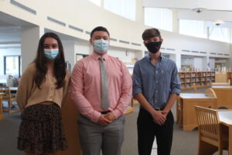
This is what success looks like
Class of 2021 graduates Julie Kuhn, Michael Peckham and Alex Colleoni-Pimenta tested to
become medical interpreters.
“It’s this whole other field of information that we weren’t exposed to that much,” Colleoni-Pimenta recently told the Community Advocate. “… Medical interpretation has allowed us to expand in our knowledge of this whole entire medical field in two different languages, which is crazy.”
Hawai‘i Language Roadmap Initiative Launch
Notes:
A pdf copy of the Hawai‘i Language Roadmap document can be found at:
http://nflrc.hawaii.edu/languageroadmap/wp-content/uploads/2013/09/HLRIfinalReport.pdf

Slide 26
Want to learn more?
Contact us: Hawai ‘i Language Roadmap
roadmap@hawaii.edu
Our webpage has many resources:
nflrc.hawaii.edu/languageroadmap
Find us on Facebook: facebook.com/HawaiiLanguageRoadmap
Follow us on Instagram:
roadmap.hawaii
Notes:
annually provides interpreters for over 10,000 court proceedings; Interpreter program has over 400 interpreters speaking over 50 languages

Slide 27
Mahalo nui loa!

