Slide 1
Private Public Partnership Office (P3O)

Slide 2
How P3O Works: P3 = EMPLOYMENT
We provide Soldiers, their Family members and Veterans assistance in finding employment or education opportunities with our vetted partners through our Army Reserve Employment Specialists and Transition Readiness Liaisons.
P3 assesses every employer and training partner to ensure we have a mutually beneficial partnership that supports USAR Soldiers, their Families and Veterans in obtaining meaningful employment or education and to ensure employers are gaining the talent they seek for their company.
We support Recruitment in two ways:
Supporting Active Component to Reserve Component (AC2RC) Soldiers at transition sites apply for training with industry programs through our partners.
Working with U.S. Army Recruiting Command by connecting new recruits with our Army Reserve Employment Specialists early in the recruitment process to start their career exploration.
We support Retention by:
Assisting TPU Soldiers with career exploration and guiding them toward relevant employment opportunities.

Slide 3
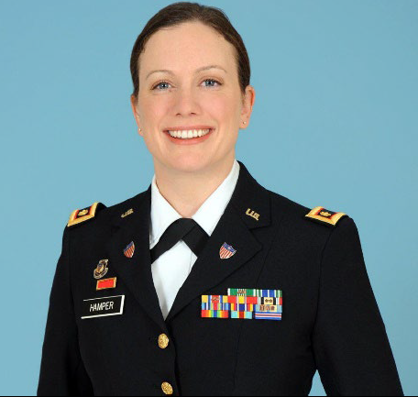
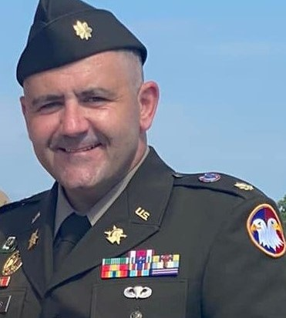
P3o ORGANIZATION CHART
DIRECTOR, gs-15 (OCAR)
mS. Alecia grady
OCAR
USARC
CONTRACT SUPPORT
Deputy Director, Strategic Planner
LTC Malisa Hamper
Operations Chief
LTC John (Ayden) Thomas
Project Manager
Mr. Mike Schultz
Human Resources Officer
MAJ Lakisha Hale-Earle
Army Reserve Employment Specialists
USAR CONUS Reserve Centers
and 1st, 7th, 9th MSC Reserve Centers
Legend:
Public Affairs and Outreach
MAJ Rob Stubbs
OCAR
USARC
OTHER LOCATIONS
Coordinating relationship
Data & System Analyst
MAJ Andrew Marsh
Support Staff
OCAR
Transition Readiness Liaisons
6 Active Component Installations

Slide 4
How to Access P3O:
Army Reserve Employment Specialist (ARES): Provide support to our Soldiers, Family members and Veterans with career exploration, job searching, resume writing, interviewing and more. They are the direct link between the client and the employer.
Transition Readiness Liaison (TRL): Provide support to de-mobilizing Soldiers seeking employment and directly support the AC2RC mission at transition sites. TRLs collaborate with Reserve Component Career Counselors (RCCC) by assisting new USAR Soldiers in applying for training with industry programs offered by one of our partners.
Website: http://www.usar.army.mil/P3 To connect with an ARES or TRL in your area, search partners, request more information or request a unit briefing.
P3 Mailbox: usarmy.usarc.ocar.mbx.p3@army.mil This is monitored daily. Reach out for any specific information you need on P3 and one of our team members will respond within 24 hours.

Slide 5
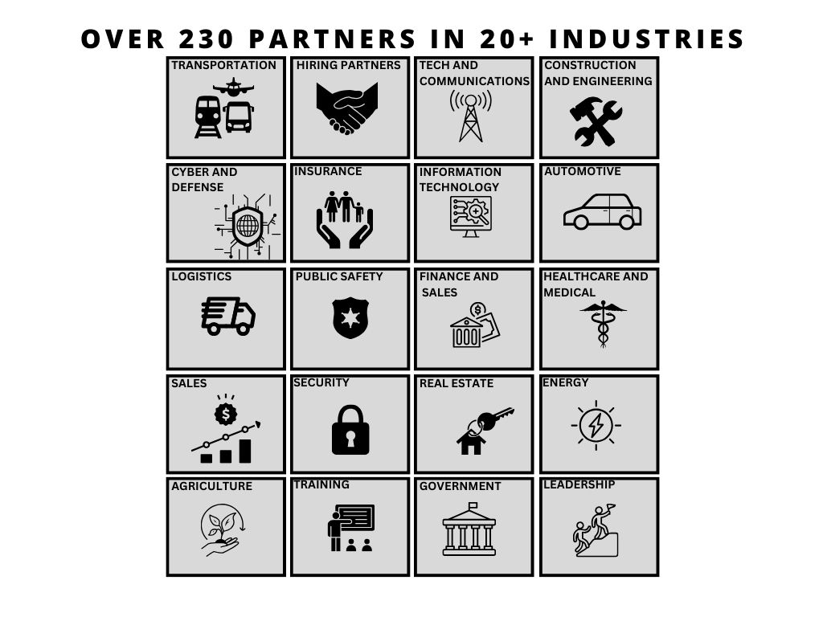

Slide 6
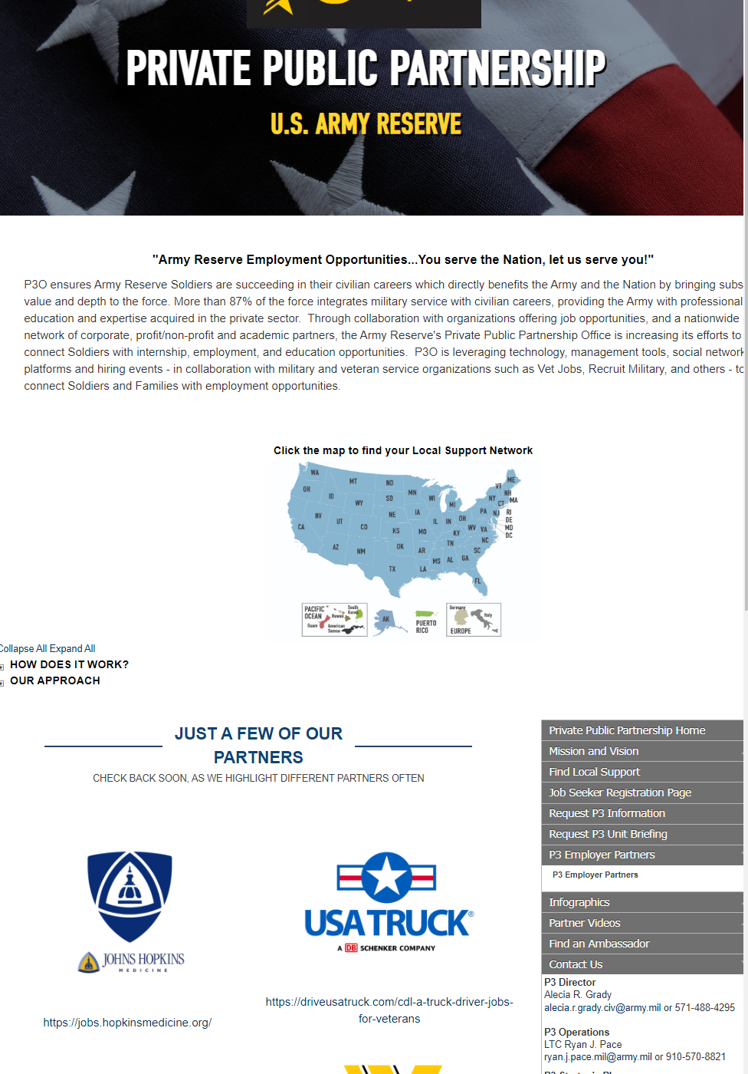
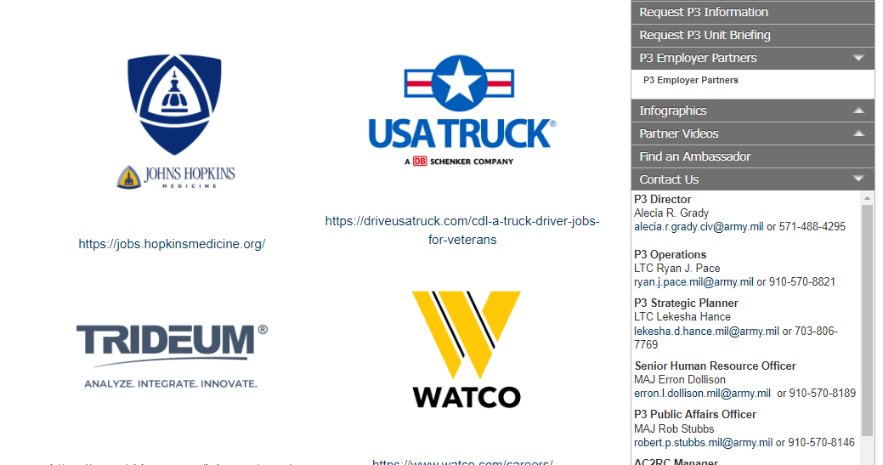
Find All Our Partners at:
http://www.usar.army.mil/P3

Slide 7
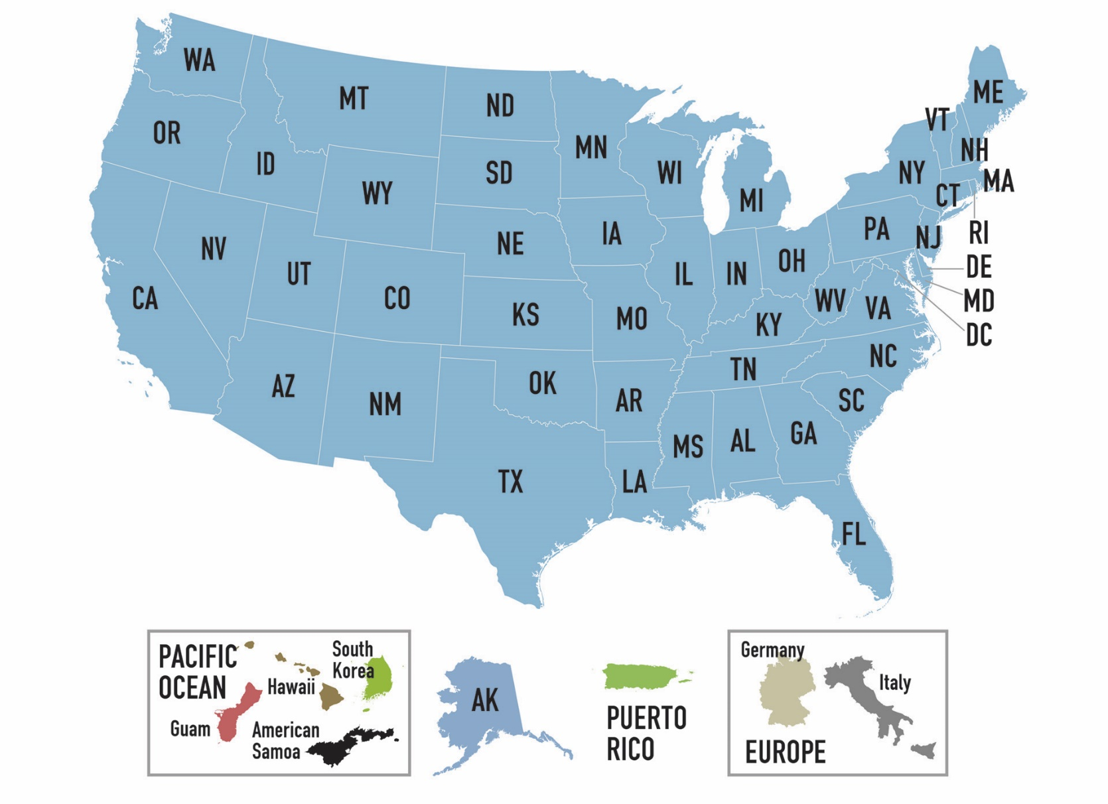
Find the P3O Staff Near You:
http://www.usar.army.mil/P3

Slide 8
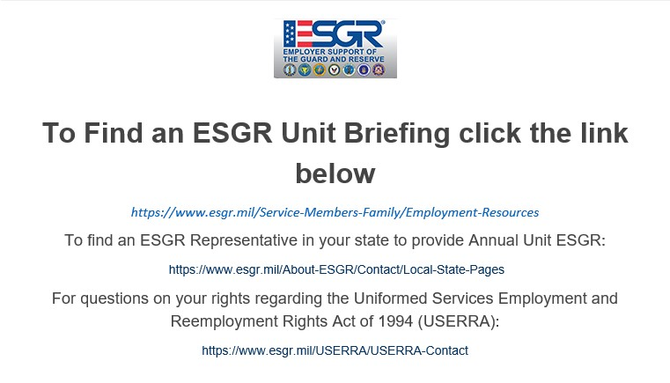
To Connect with ESGR in Your State:
Call Center 1.800.336.4590
https://www.esgr.mil/About-ESGR/Contact/Local-State-Pages

Slide 9
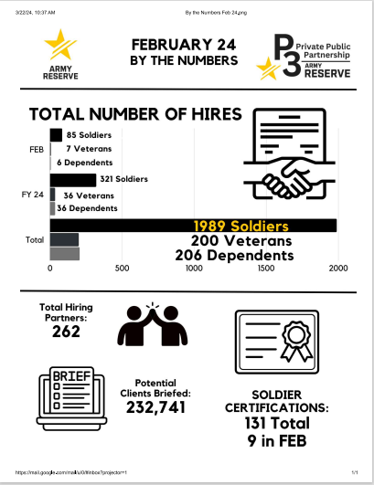

Slide 10
Stay Connected with Us!
Website: www.usar.army.mil/P3
Facebook: www.facebook.com/PrivatePublicPartnership
LinkedIn: www.linkedin.com/PrivatePublicPartnership
Instagram: www.Instagram.com/p3o_usar
P3 Deputy Director P3 Operations P3 Senior HR Officer P3 Public Affairs
LTC Malisa Hamper LTC John (Ayden) Thomas MAJ Lakisha Hale-Earle MAJ Rob Stubbs
malisa.a.hamper.mil@army.mil john.a.thomas266@army.mil lakish.l.hale-earle.mil@army.mil robert.p.stubbs.mil@army.mil
(703) 806-6740 (910) 570-8821 (910) 570-8189 (910) 570-8146
P3 Data & System Analyst Contractor PM Army Reserve Employment Specialist - Lead
MAJ Andrew Marsh Mr. Mike Schultz Arthur Romero
andrew.l.marsh@army.mil michael.d.schultz.ctr@army.mil aromero@goldenkeygroup.com
(910) 570.8092 (703) 806-6848 (808) 438-1600 ext 3128
P3 E-mail: usarmy.usarc.ocar.mbx.p3@army.mil

